Slide 1

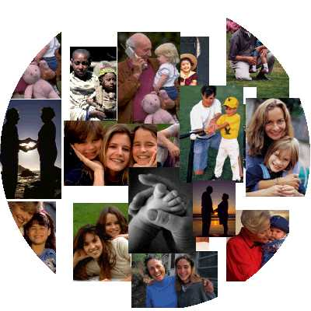
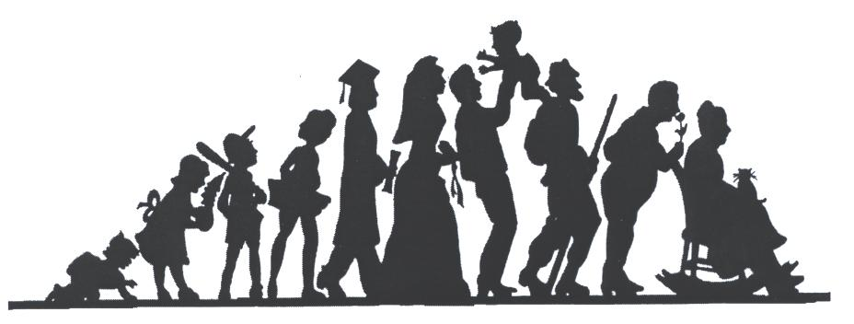
Sex Education
at
Northside Primary School

Slide 2
Christopher Winters Project
History: The Christopher Winter Project is a training and consultancy company which was established in 1995. We use some of the older resources as the newer resources are slightly more graphic than we deem necessary.
The CWP empowers teachers to deliver high quality relationships and sex education by modelling teaching approaches in the classroom and providing teachers with:
- skills
confidence
lesson plans
resources

Slide 3
All lessons will:
be based on scientific fact
allow time for discussion and questions
have time at the end for anonymous questions
be taught as a whole class

Slide 4
Before each lesson, we will set the ground rules so that all children feel safe and secure.
These might include the following:
Listen to each other
Treat each other with respect
Do not use names or make it personal
Do not discuss what you learn with younger children, either at school or at home

Slide 5
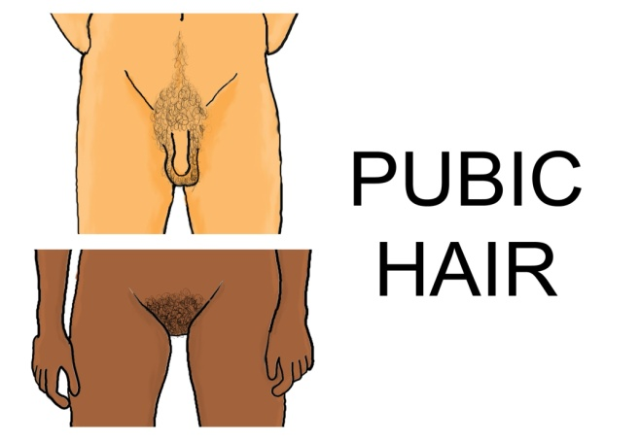
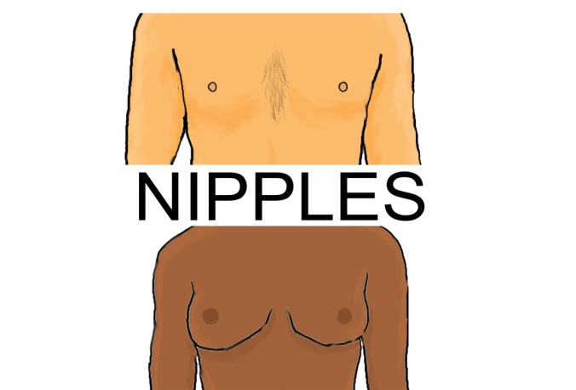


Lessons
Lesson 1: Led by the class teacher
Introduction to Puberty: How our bodies change
Lesson 2: Led by the class teacher
Puberty: Changes for reproduction

Slide 6

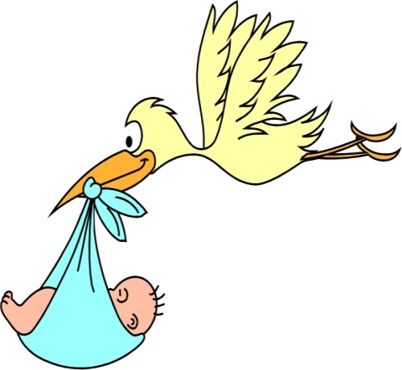
Lessons
Lesson 3: Led by the class teacher
Understanding Relationships: Exploring what makes a positive relationship
Understanding the emotional and physical sides of relationships
Diversity between families
Lesson 4: Led by the class teacher
Conception and Pregnancy
Learning how to keep yourself safe
and thinking about the decisions you
make.

Slide 7
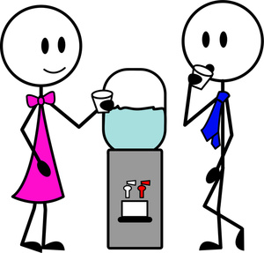
Lesson 5: Led by the class teacher
Communication: How to talk and treat each other in relationships.
Know when to share private and personal information, including online.
What we want from the sessions:
Facts, tolerance, feeling safe and knowing how to keep themselves safe

Slide 8
I will let you know via WhatsApp when I teach one of the lessons, so that you are prepared to field any questions when your children get home.

