Slide 1

DEAR time
Read silently.
Enjoy a good book.
Get lost in a story.
Let your imagination run free.
Find three new words and add them to your bookmarks.

Slide 2

D&T

Slide 3
What is programming and how can it be used in D&T?
Respect​​
Pride ​​
Inclusion​​
Challenge​​
Creativity​​
Resilience
Fear Zone
Comfort Zone
Learning Zone
Magic Zone
1
2
3
4
5
6
7
8
9
10

Slide 4


What have we learnt about programming in computing?

Slide 5
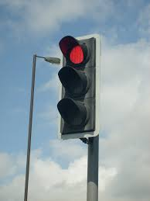

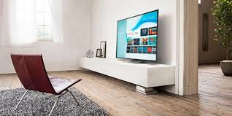
How is programming used in DT?

Slide 6
Your task: Create a list in your book of all of the different items in a house that use programming.

Slide 7
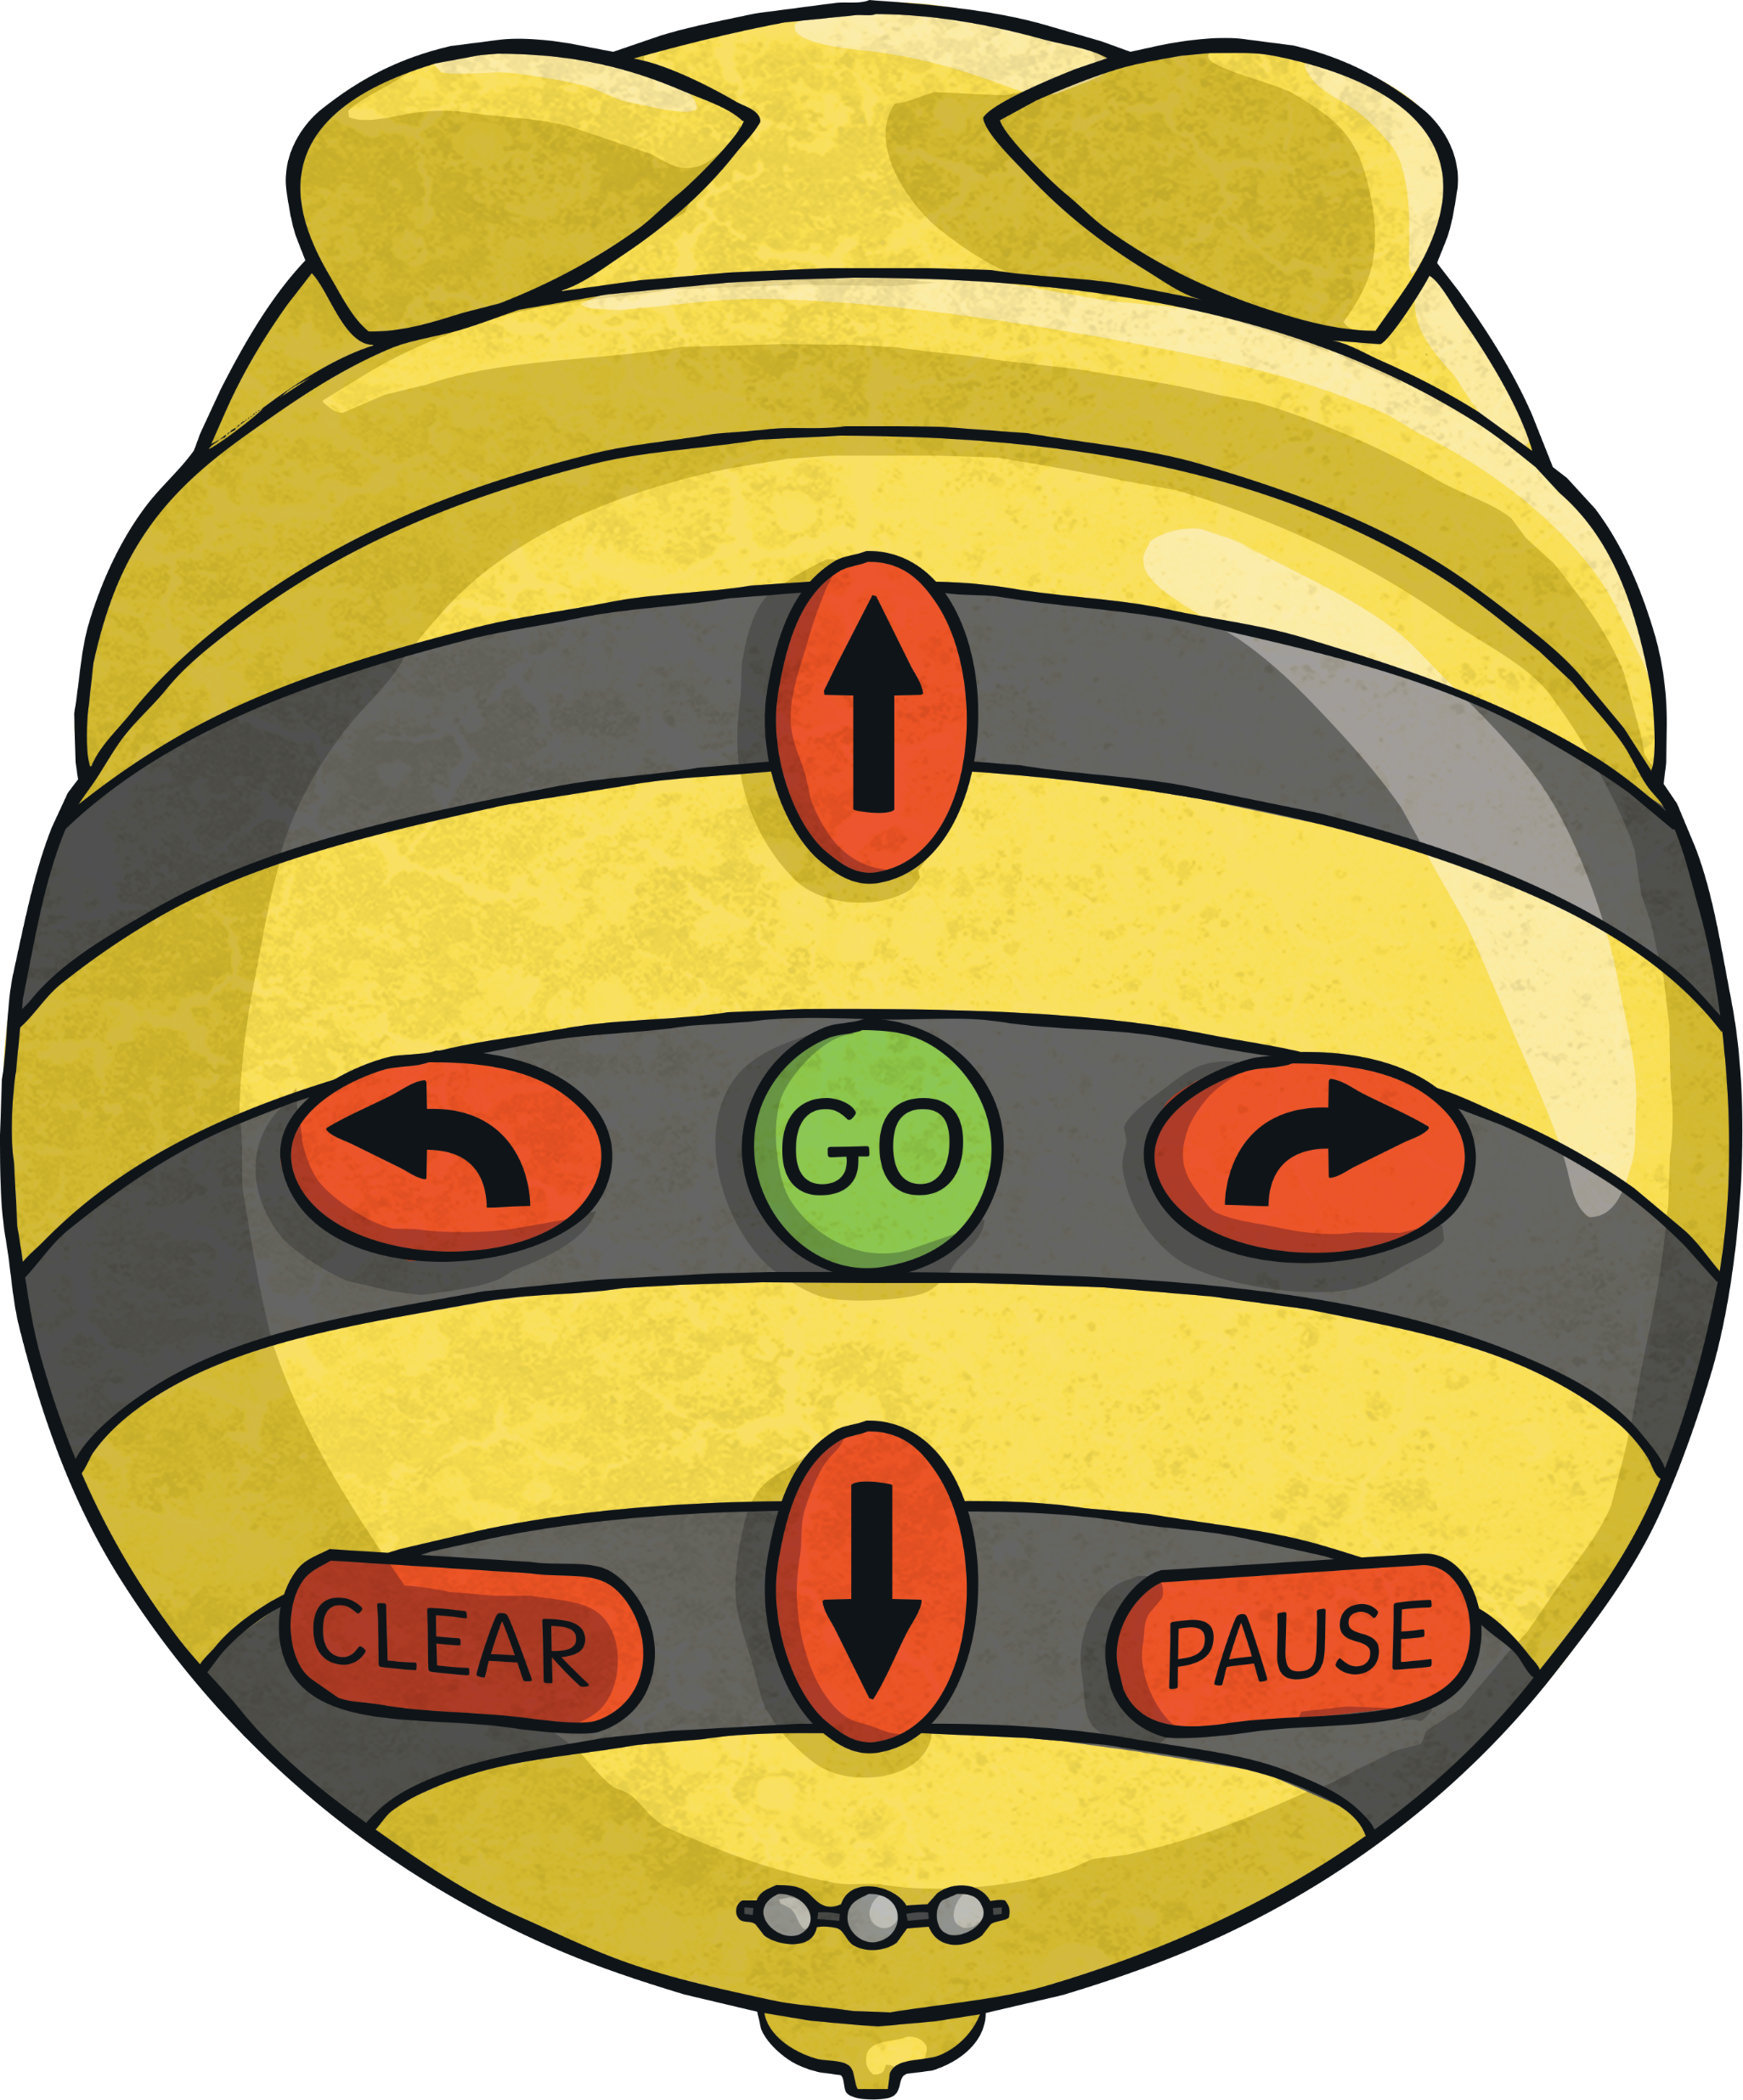
This is a programmable object that we should all recognise:
A Beebot!

Slide 8
What are the benefits of being able to programme a toy?

Slide 9
Have you thought of any different objects in your house that are programmable?
Add them to your list!

Slide 10
What are inputs and outputs?

Slide 11
Input devices are controlled by the users.
Output devices are controlled by computers.

Slide 12
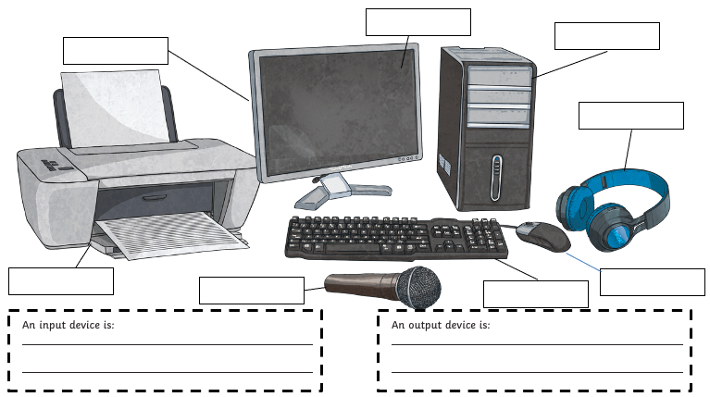
Your task: Label the input and outputs for these devices (on your sheet). Then stick it in your D&T book.

Slide 13
Purple pen time!
Input devices are a mouse, a microphone, a keyboard.
Output devices are monitors, printers, headphones.
Hard drives are both input and output devices.

Slide 14
Why is it important to think about inputs and outputs when designing something using electricity?

Slide 15
D&T

Slide 16
How are electrical systems used when building products?
Respect​​
Pride ​​
Inclusion​​
Challenge​​
Creativity​​
Resilience
Fear Zone
Comfort Zone
Learning Zone
Magic Zone
1
2
3
4
5
6
7
8
9
10

Slide 17
What have we learnt about electrical circuits so far?

Slide 18
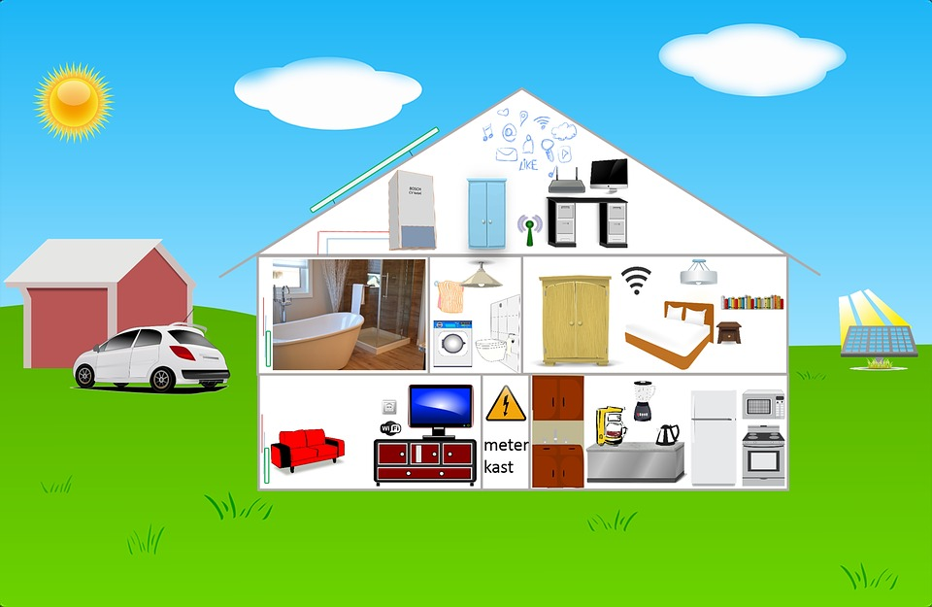
Where are electrical systems used at home?
What about at school?

Slide 19
Copy and complete in your book:
Electrical systems used at home: | Electrical systems used at school:
Lighting TV | Printers Ipads

Slide 20
You are going to become museum curators in partners. You are going to design and make a lit-up museum display of a famous person from Ancient Egypt.
What do you need to think about before you make the display?

Slide 21
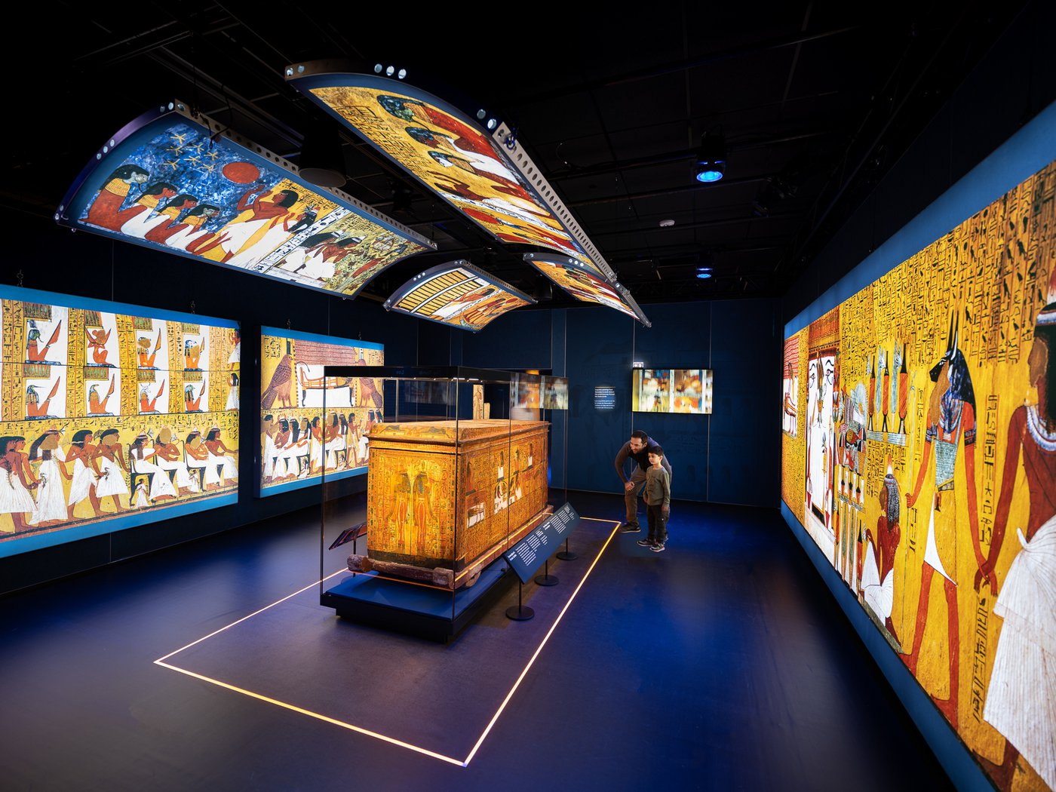
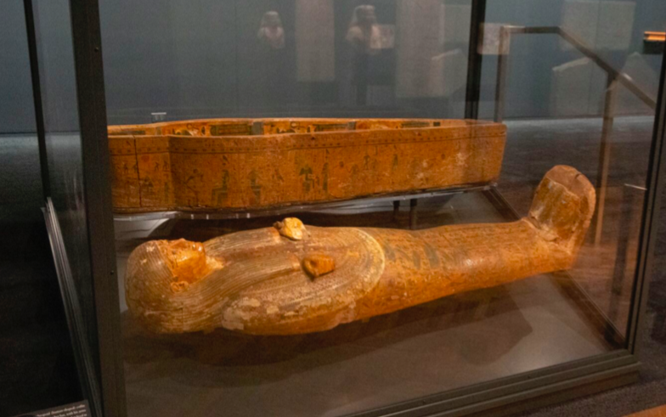
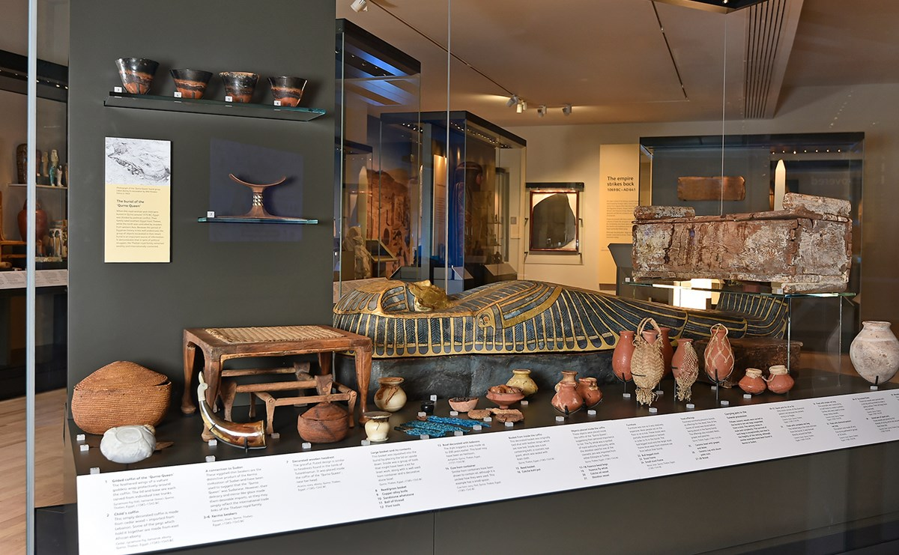
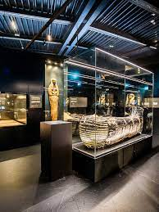
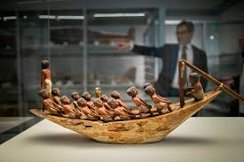

Slide 22
When you make your exhibit, you will have a shoe box, materials to decorate the box, card to make your person/object and equipment to light it up.

Slide 23
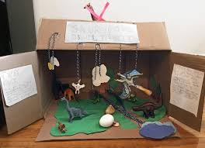
Your task: In your D&T book or on paper, neatly design a museum exhibit that features an important Ancient Egyptian.
You need to label your design with materials and where the electrical circuit will go. Remember to be neat!

Slide 24
Your task: Start to decorate the inside and outside of your exhibit. Use paper, card, collage materials (if you have any) and pens to complete your work. Be as creative as you can!

