Slide 1


Welcome to Year 6 - 2026 2027

Slide 2
Adults in Year 6
Mr Holloway
Miss Oxland
Ms Christoforou
Miss Sedaoui
Miss Yasna
Mrs Habib
Mrs Ahmadi

Slide 3
Punctuality
Your child must be in school, on time, every day.
Children must be in the playground at 8.42am and we take the register at 8.50am - anyone later than this will be marked as late.
Punctuality is a key priority for this year as too many of our children are late on a regular basis, and therefore missing learning.
We will be rewarding the most punctual class with a class trip at the end of the year, so support your child and their peers to make this a great year for punctuality!

Slide 4
Expectations
Attendance – attending school every day is crucial to your child’s progress and learning
Punctuality – learning begins at 8.45 am so all children should be in the playground by 8.42 am
Behaviour – your children are expected to demonstrate excellent behaviour at all times and act as role models for younger children within the school. We will be using Class Dojos and Tokens.
Uniform – the children need to be in full uniform including black shoes or trainers, no jewellery (unless religious) and no nail varnish.

Slide 5
Expectations
Reading – pupils will take home one book at a time from the Library and may choose a Reading Road Map book too. They are expected to read for at least 20 minutes each evening and write a short comment in their reading records every evening. You need to sign their record every evening.
P.E - PE will take place on Wednesday and Thursday. Children should come to school dressed in their P.E kits.
Water bottles - children should bring in a full water bottle every morning and take it home with them every afternoon.

Slide 6
Expectations
Year 6 Swimming
Swimming is part of the PE curriculum and will take place on a Thursday afternoon. Children should come to school in their PE kit, bring a swimming bag and appropriate swimming gear.
Swimming is compulsory and part of the P.E curriculum.

Slide 7
Homework
The general homework expectations are:
Daily reading (20-30 minutes every day).
Complete weekly Spelling homework on Spelling Shed.
There will be a spelling test every Friday morning linked to the weekly spelling theme.
Use Times Table Rockstars at least once a week.
There will also be SATs Companion.
Please ensure that your child brings their Reading Record into school every day, with a comment from the previous evening and your signature.

Slide 8
Homework
SATs Companion is an online learning platform designed specifically to support Year 6 pupils in preparing for the SATs. It includes:
Personalised homework and practice tasks set by class teachers;
Interactive videos and quizzes to reinforce key skills;
Instant feedback so children can identify and work on areas needing improvement; and
Comprehensive coverage of English, Maths, and SPaG topics.

Slide 9
Updated Relationships, Sex and Health Education (RSHE) Guidance
There have been recent updates from the Department for Education (DfE) regarding Relationships, Sex and Health Education (RSHE).
We will be following this updated guidance from September 2026. As a result of this update, we are in the process of reviewing and updating our school’s RSHE policy.
In response to emerging and/or local issues, we may need to introduce additional content into the RSHE curriculum (for example, topics such as the sharing of nude images). In all cases, we will ensure that parents are informed and supported to continue these conversations at home

Slide 10
Updated Relationships, Sex and Health Education (RSHE) Guidance
What will be taught in each year group?

Slide 11
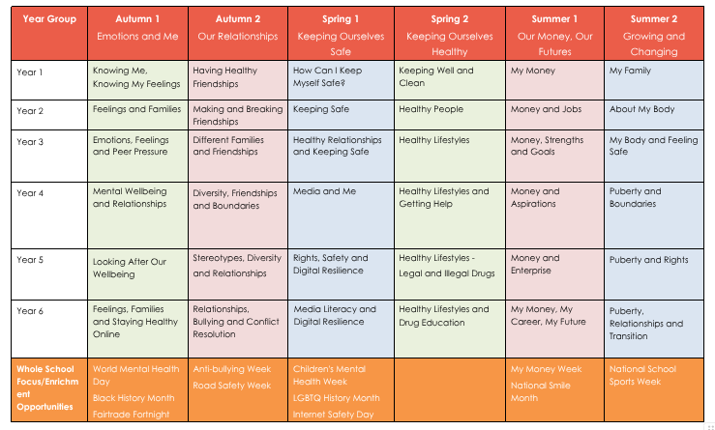

Slide 12
Updated Relationships, Sex and Health Education (RSHE) Guidance
Copies of the new HEP Framework for RSHE are available for you to look at during this meeting.
This is an opportunity for you to comment on the updated policy and RSHE planning. Let us know if:
If your child has particularly enjoyed learning about a topic (PE)
If you think an area should be taught (SBT)
General Comment on the updated RSHE curriculum (GC)
These comments will be collated and will be reflected in the updated RSHE policies and will inform future RSHE planning

Slide 13
Communication
There will be two formal meetings a year to speak about your child.
You will receive a report about your child and their learning at the end of the school year.
Queenswell Schools produce a weekly newsletter which parents/carers can access via the WhatsApp link or our website.
If you would like to speak to your child’s class teacher you will need to book an appointment through the office.
The school’s website has all this information and much more.
https://www.fsfed.org/page/?title=Queenswell+Schools&pid=20

Slide 14
Term Dates 2026 2027
Autumn Term 2026
First Half Wednesday 2nd September – Thursday 22nd October
Half Term Monday 26th October – Friday 30th October
Second Half Monday 2nd November – Friday 18th December
Spring Term 2027
First Half Wednesday 6th January – Friday 12th February
Half Term Monday 15th February – Friday 19th February
Second Half Monday 22nd February – Thursday 25th March
Summer Term 2027
First Half Monday 12th April – Thursday 27th May
May Bank Holiday School Closed Monday 3rd May
Half Term Monday 31st May – Friday 4th June
Second Half Tuesday 8th June – Thursday 22nd July
INSET Days
School is closed to pupils on these days
Tuesday 1st September 2026
Friday 23rd October 2026
Tuesday 5th January 2027
Friday 28th May 2027
Monday 7th June 2027

