Slide 1

Welcome to Year 3
University of Liverpool
2026-2027

Slide 2
Welcome back!
It is so wonderful to see you all at school this term.
I will keep in touch with reminders and updates on the WhatsApp group.
I am contactable via our class email or via the class mobile and I look forward to working with your lovely children this year!

Slide 3
Our Northside Values
RESPECT: to value our needs, beliefs and each other
PRIDE: to have confidence in our abilities and celebrate success
INCLUSION: to work together with families and our diverse community to become life-long learners
CHALLENGE: to have high expectations of ourselves so we achieve our best
CREATIVITY: to creatively express our feelings and ideas
RESILIENCE :to develop life skills so we fulfil our potential

Slide 4

The Flourishing Schools Federation!
As you know, we are part of the Flourishing Schools Federation, along with Queenswell Infants and Junior School.
We look forward to working with our sister schools again this year.

Slide 5
Home-School Communication
Please read all text messages.
Click on the links sent as they are often letters.
All information is sent via the newsletter, text or a separate letter.

Slide 6
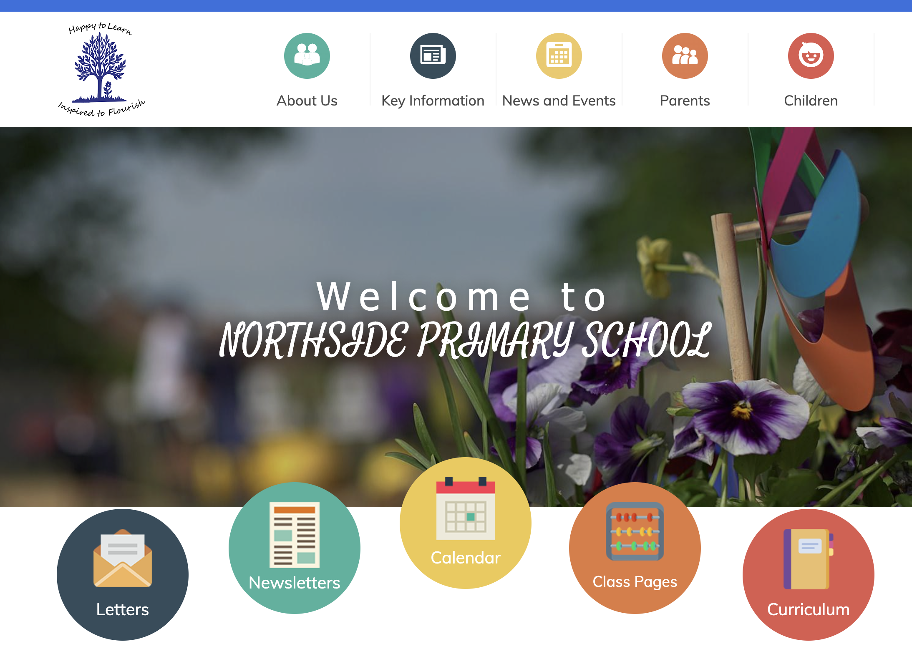
Website
  the parent tab
  the club page
  the calendar
  keeping your child safe
  the SEND page
  your class page
  the ticker band on the front page
  newsletters, letters
  change the language if needed

Slide 7
Safeguarding
If you have any safeguarding concerns, please speak to Mrs. Schmitz (Designated Safeguarding Lead), Mrs. Longworth (Deputy DSL), Mrs. Mulvihill-Ellis (Deputy DSL) or Miss Millwood (Deputy DSL)

Slide 8
Expectations:
Children need to be in school every day.
Children need to be on time.
Behaviour is incredibly important. Everyone must always try their best.
Homework needs to be completed each week-explained on the curriculum letter.
Children to attend boosters when invited.

Slide 9
Expectations
Uniform-the children need to be in full uniform including shoes (not trainers) and no nail varnish.
Long hair must be always tied back, and no jewellery should be worn (watches and small studs are acceptable).
Any hair accessories must be small and Northside blue.
Please label all belongings

Slide 10
Punctuality
Your child must be in school, on time, every day.
Children must be in the playground at 8.50am and we take the register at 8.55am - anyone later than this will be marked as late.
Punctuality is a key priority for this year as too many of our children are late on a regular basis, and therefore missing learning.
We will be rewarding the most punctual class with a class trip at the end of the year, as well as Punctuality Pancakes each half-term, so please support your child and their peers to make this a great year for punctuality for University of Liverpool!
If your child is regularly late, please leave home earlier.

Slide 11
Attendance
If children aren’t in school, they are missing out on valuable learning
If you are unsure whether your child is too ill to come to school, send them in and then we can send them home if necessary
The national average is 95% and our school target is 98%

Slide 12
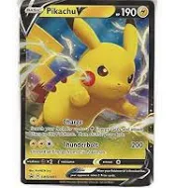

Please do not allow your child to bring any additional things into school

Slide 13
Homework:
Reading
In Year 3 we expect children to read to adult for 15 to 20 minutes everyday.
Parents or children must write a comment in their reading records, daily. These will be checked every morning. Parents must check and sign this daily please.

Slide 14
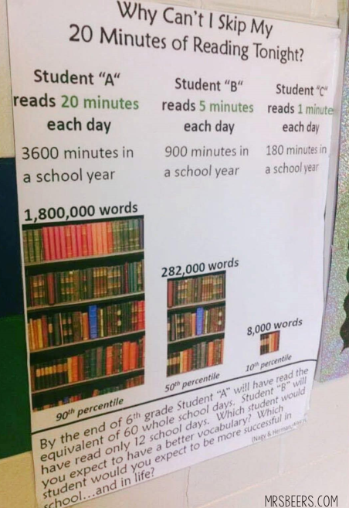

Slide 15
Homework:
Spelling and Maths
Homework will be set on Thursdays and is to be completed by the following Thursday.
Children need to complete their Spelling Shed tasks each week.
Children need to complete tasks on My Maths and practise on Times Table Rockstars.
There will be a 'low stakes' spelling quiz every Thursday based on the previous weeks spellings.
There will be a times tables test each Friday.

Slide 16
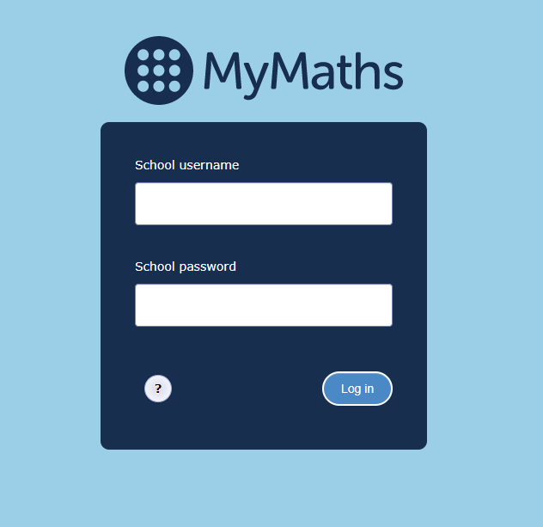

MyMaths
Times Table Rockstars
Homework set each week based on that week's learning
Each child has their own login
Logins will be given out and children will stick these in their Reading Records.
Ask the teaching team if they don’t have one or have lost it.
Teachers will monitor your child's progress.
Children from Years 2-6 are expected to use this to practise their individual times table target.
Logins will be given out. Please make sure that your child doesn't share their log in.
Children can use different modes to earn virtual 'coins'.
Children can use the 'Heatmap' to see their progress and which times tables they are unsure of and which they still need to learn.
'Studio' mode will check your child's speed and they can win a certificate in assembly for Rock Legend and Rock Star statuses.

Slide 17

If you would like to improve your child's maths learning...
White Rose workbooks are available for Years 1-6
These are fully aligned with the learning that your child does in class and will allow them to practise the key concepts taught
Parents can mark the workbooks by scanning a QR code to find the answers
Please speak to the office if you are interested in ordering a book through Arbor

Slide 18
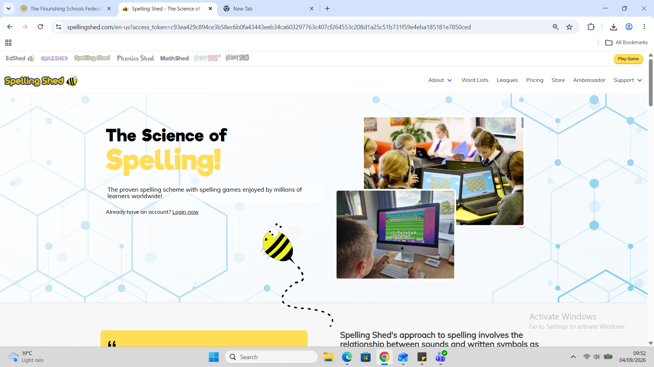
Spelling Shed
Weekly spelling lessons
Homework set each week
Each child has their own login
Play games and earn points to become the weekly winner of our Bronze, Silver and Gold cups!
Logins will be given out and children will stick these in their Reading Records.
Ask the teaching team if they don’t have one or have lost it.

Slide 19
Notices/reminders:
Children need to take their water bottles home each day, for them to be cleaned and re-filled.
See the curriculum letter on the class page for more information.

Slide 20
P.E. days and Forest School:
This term, our PE lessons will be on Fridays. Children need to come to school in their PE kits on the correct day and keep them on all day. Children are allowed to wear tracksuit bottoms as the weather gets colder.
On Fridays, half of the class will be participating in Forest School. They can wear their P.E kit and bring old clothing and comfortable trainers/shoes in a labelled bag.
You will have received a WhatsApp message informing you of which group your child is in.

Slide 21
Topics in Year 3
Autumn 1: The Stone Age​
Autumn 2: Diverse Worlds ​
Spring 1: The Iron Age​
Spring 2: Counties and cities of the UK​
Summer 1: The Victorians​
Summer 2: A comparison of 2 UK regions–Liverpool and the Highlands

Slide 22







Terrific Texts

Slide 23
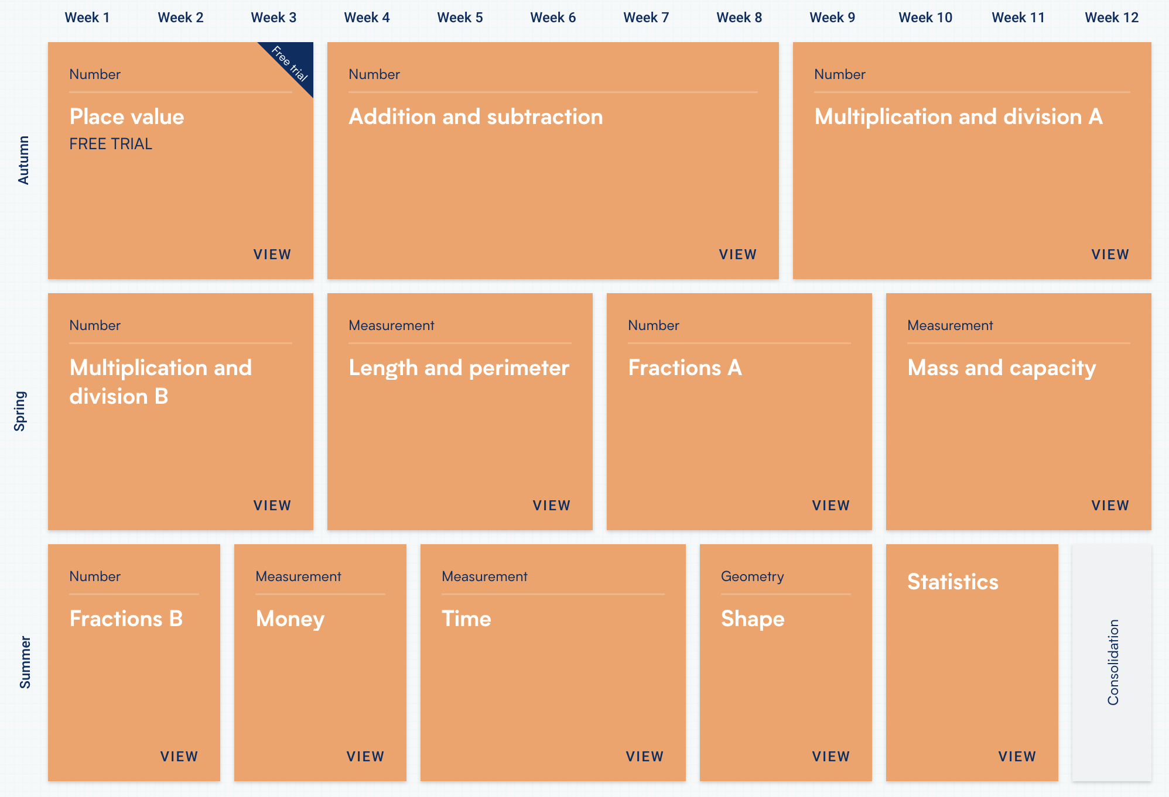
Maths

Slide 24
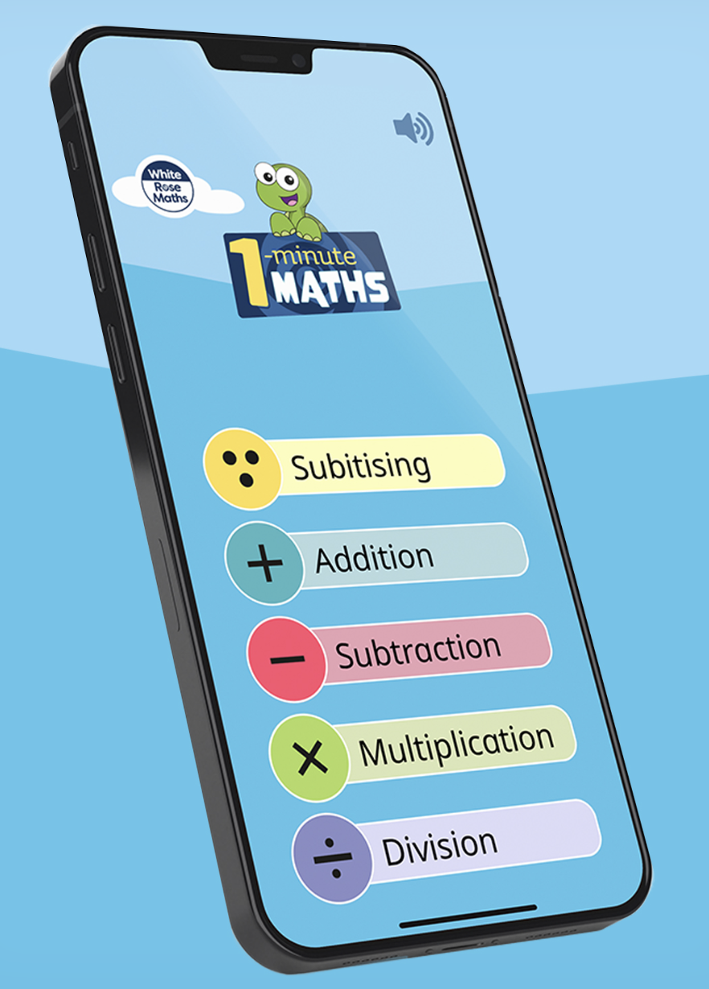
Maths
https://ttrockstars.com/
https://www.mymaths.co.uk/
White Rose Hub 1-minute maths

Slide 25
Curriculum Coverage
We will be teaching all subjects in the curriculum
We believe that providing the children with a broad and balanced curriculum is important – see the timetable on the class website for a more detailed break down of their week
Sometimes, some subjects will be taught in blocks
Please see our website for full curriculum overviews

Slide 26
RSHE topics
Respecting ourselves and others​
Families and friendships​
Living in a wider world (media and digital literacy)​
Money and work​
Keeping safe​
Physical health and mental wellbeing​
Growing and changing (please note: we will talk about male and female body parts and the children will learn the correct terminology)

Slide 27
How can you help?
Help your child to develop a positive outlook to learning and talk to your child about what they are learning
Reading daily
Plan when you will complete homework tasks​
  Reading ​
  Spelling​
  Maths​
  Times tables​
Teach your children how to tie their shoelaces and develop other independent life skills​
Ensure great attendance and punctuality

Slide 28
Recap on key days/reminders
Every day - Reading records will be checked​
Thursday - Spelling Shed and MyMaths homework is due in and new homework set
Friday - times table test​
Friday - P.E.​ and Forest School
Every day-bring in water bottles, waterproof jackets, Reading Records and their current reading book. ​

Slide 29

Please email any questions or queries to our class email address. You can find this on the class page on our website.
year3@northsidesch.org or text privately on the Whatsapp group.
Thank you!

