Slide 1

Spelling Strategies Parent Workshop
Northside Primary School
Friday, 17th January, 2025

Slide 2
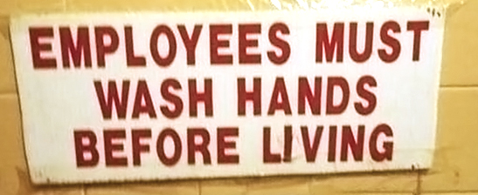
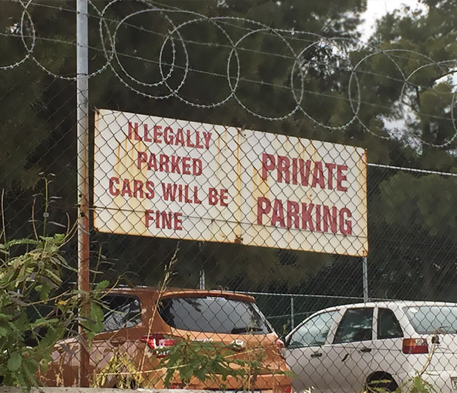
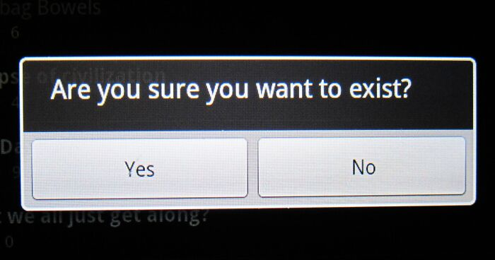
How important is spelling?

Slide 3
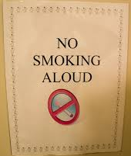
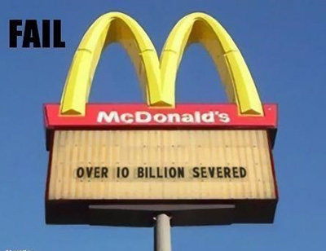
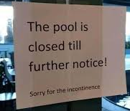
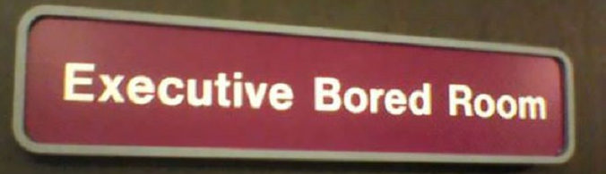

Slide 4
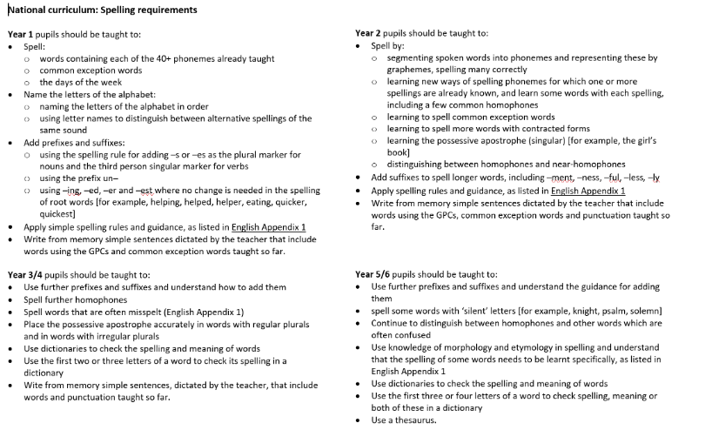
Statutory requirements

Slide 5
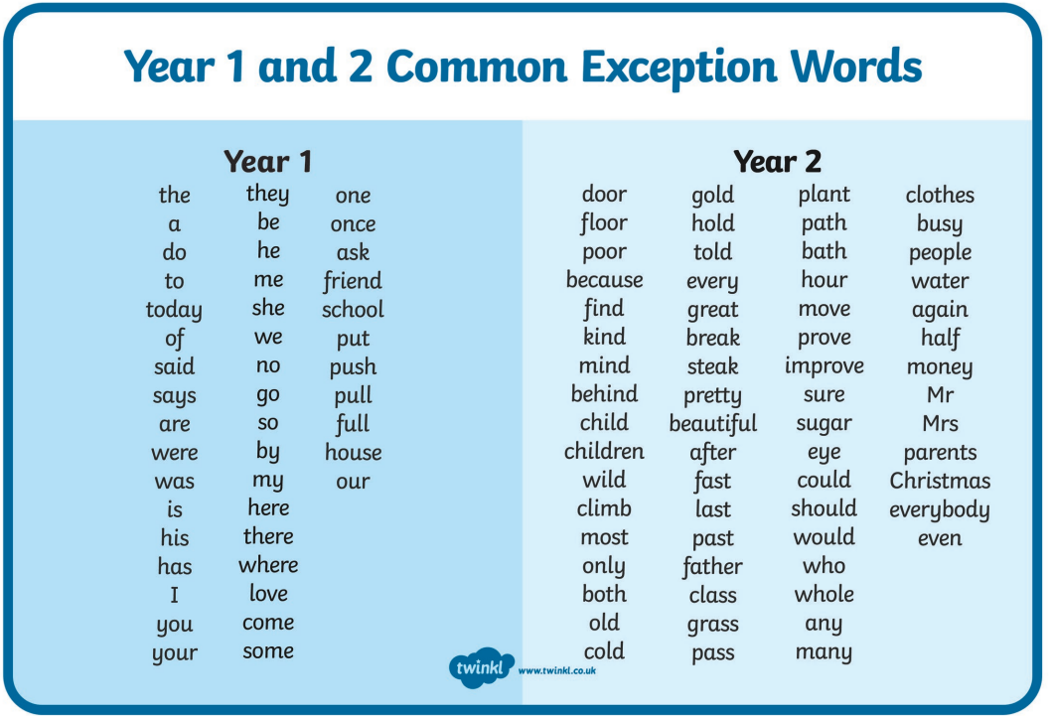

Slide 6
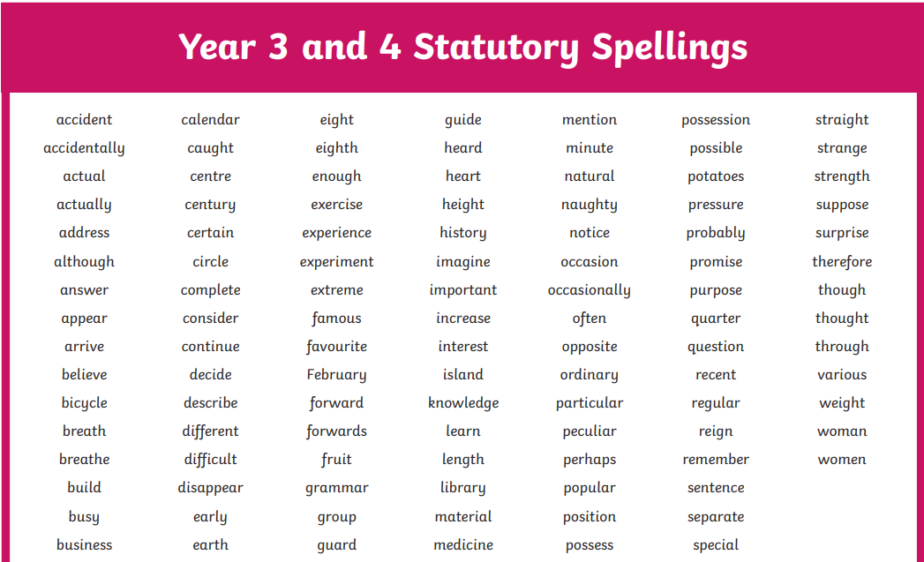

Slide 7
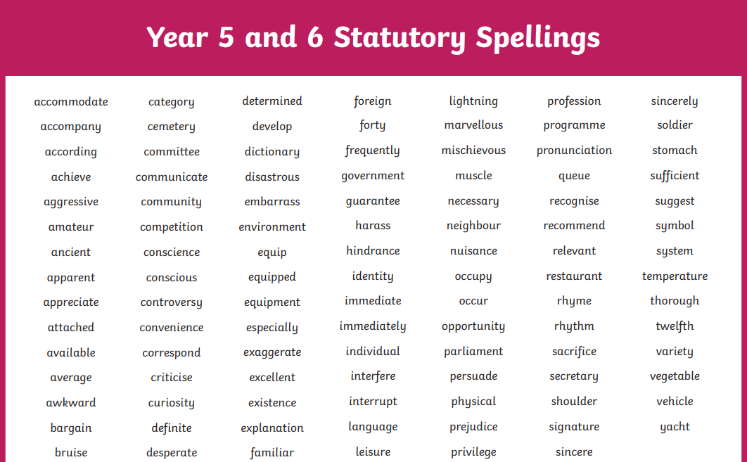

Slide 8
Spelling at Northside
It is not only the spelling of individual words that we are trying to teach, but the basic spelling patterns so that learners can spell correctly words they have not been taught but want to write. The aim is for the learners not to have to memorise individual words, but to be able to work them out from known patterns and principles.
Phonics
Weekly Spelling Lessons
Spelling Shed website
Weekly spelling tests
Statutory Spelling words

Slide 9
Knowledge of the spelling system
In order to spell, we need both phonemic knowledge and morphological knowledge.
Phonemic knowledge
•Phonics
•Spelling patterns and conventions
•Homophones
•Phonological knowledge (this relates to syllables and rhymes; analogy)
A phoneme is a speech sound that is the smallest unit of sound in a word. The word "dog" is made up of three phonemes: /d/ /o/ /g/
The word "dog" is made up of three phonemes: /d/ /o/ /g/

Slide 10
Phonics teaching
Phonics teaching
Phase 1 –sound discrimination, rhythm and rhyme, alliteration, voice sounds, oral blending and segmenting - Nursery
Phase 2–learning main letter sounds and shapes - Reception
Phase 3-Teaching another 25 graphemes, most comprising two letters, so that the children can represent each of about 42 phonemes by a grapheme. – Reception
Phase 4–Consolidates knowledge of GPCs (grapheme-phoneme correspondence – the sound and the written letter that corresponds with it) and introduces adjacent consonants. – Reception/ Year 1
Phase 5–Introduces alternative graphemes for spelling and pronunciations for reading – Year 1/ Year 2
Phase 6 – reading fluently and spelling accurately – Year 2

Slide 11
Knowledge of the spelling system
morphology – word parts
Morphological knowledge
•Root words –contain one morpheme and cannot be broken down into smaller grammatical units (eg elephant, table, girl, day)
•Compound words –two root words combined to make a word
•Suffixes–added after root words, and change the spelling and meaning of a word (eg hope –hoping; walk –walked, happy –happiness)
•Prefixes–added before a root word, and change the meaning but rarely affect the spelling of a word (replace, mistake)
Notes:
Morphology refers to "the knowledge of meaningful word parts in a language (typically the knowledge of prefixes, suffixes, and/or roots and base words)" (Foorman et al., 2016 )

Slide 12
So how can you help your child to learn their spellings?
On the next slides, we’ll have a look at lots of different strategies you can use.

Slide 13
S U S
^{Study the word.}
^{Underline the difficult part.}
^{Say the word carefully.}
Notes:
retrieve – use as example
because
different
thought, though and through

Slide 14

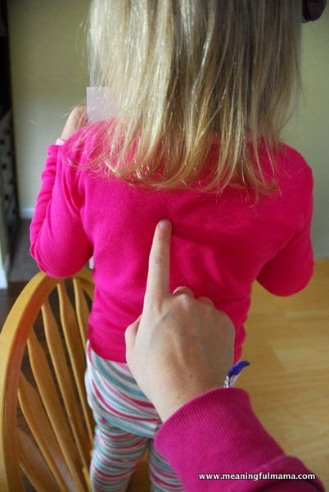
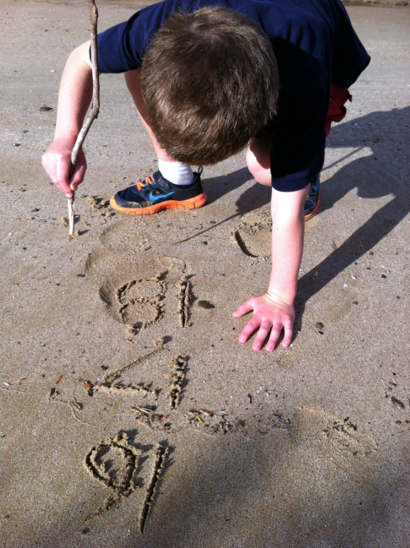
Write the word…
in the air
on someone’s back
with your eyes
on your desk
in sand

Slide 15

Speed writing
How often can you write the word correctly in one minute?

Slide 16
Mnemonics
Making up a ‘story’ to help spell a word.
S A D
^{Sally ate dumplings}
because > big elephants can’t always use small exits
know > kangaroos never open windows
rhythm > rhythm has your two hips moving

Slide 17
For double letters
Create a saying to help remember the spelling:
dessert: desserts are both sugary and sweet.
necessary: one collar, two sleeves

Slide 18
Syllables/ Chunks
Breaking the words into parts.
Clapping the sounds.
jogging = jogg ing
flying = fly ing
returned = re turn ed

Slide 19
Look For Small Words Inside the Word
about = a, out, bout
teacher = tea, each, her, ache
what = hat
separate = a rat always hides in separate. How many words can you find in separate?

Slide 20
Words That Look the Same
^{Back is like pack and sack.}
^{Pat is like hat and cat.}
Can you think of any more?

Slide 21
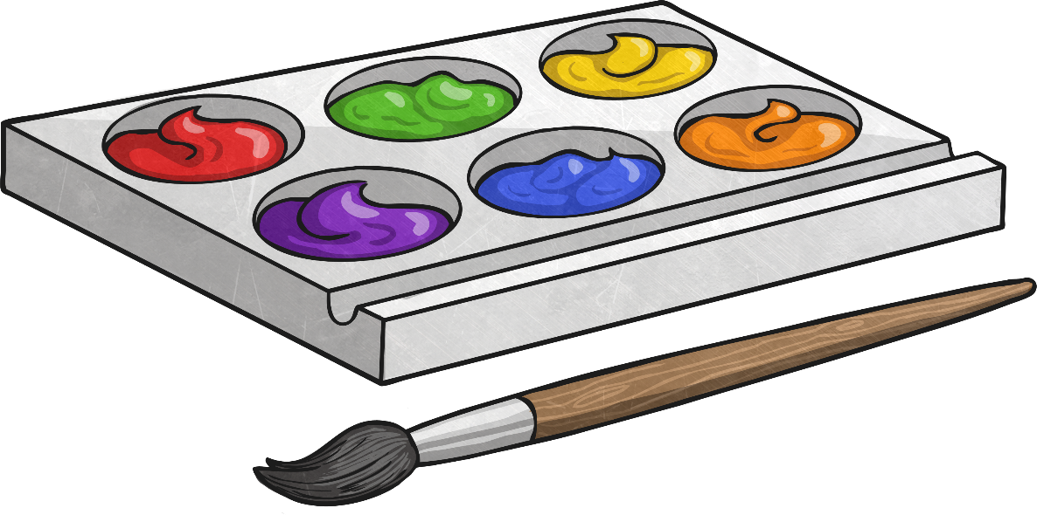
Use of Colour
Use a different colour for each letter.
^{w h e n}

Slide 22

Rainbow words
Write your words out in pencil. Next, draw around each letter five more times using a different coloured pencil.

Slide 23

Shape of Words
^{Draw the shape of the word.}
display

Slide 24
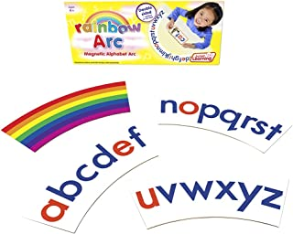
Making Words With Letters
Put a selection of letters in an arc.
See how many words you can make from the letters.

Slide 25
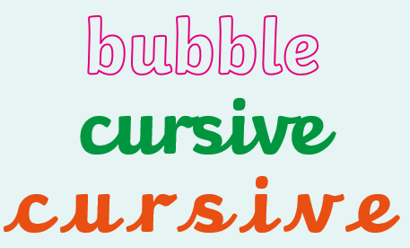
Writing the Word in Fancy Letters

Slide 26


Slide 27
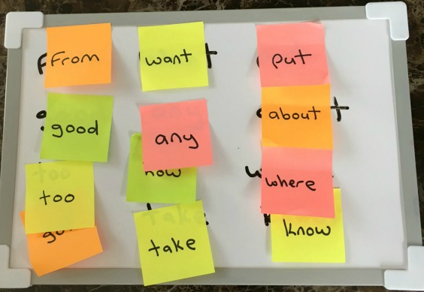
Using Sticky Notes
Place sticky notes in suitable places around the room at eye level.

Slide 28
Recording Your Own Voice/Child’s Own Voice
^{Say the word.}
^{Spell the word.}
^{Listen.}
^{Repeat.}

Slide 29
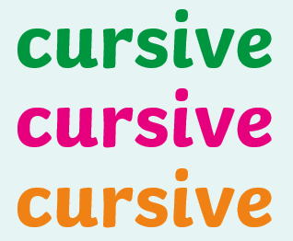
Three Times
Write the word three times. In different colours.
There
There
there

Slide 30
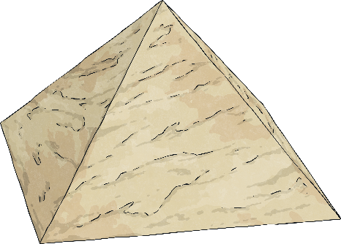
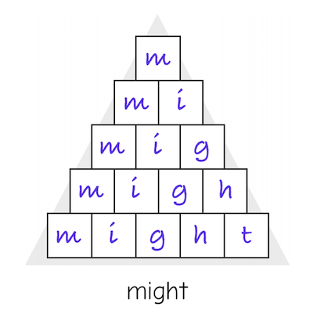
Pyramid Writing
Write your word in the shape of a pyramid.
d
d o
d o g

Slide 31
Blue Vowels
a e i o u
Write the word then go over each vowel in blue.
b e l i e v e
Notes:
Model with achieve

Slide 32

Consonant Circles
Write the word then circle all of the consonants.

Slide 33

Guess the word
In pairs, take turns using a wipe board, one person writes one letter at a time for another to guess the word. Give extra points for fewer guesses.

Slide 34
Lucky Dip
^{Bag of letters.}
Children take it in turns to take out letters from a bag displaying them in front of them. Carry on until someone can spell one of their words.

Slide 35
Muddled Letters
Pupils rearrange the letters of words making sure to always start with the original letter. Correct them where necessary.
^{Yseertyad}
^{yesterday}

Slide 36


Picture Association
Draw pictures to help your child to remember parts of the word e.g
or put into the letters of the word as visual spelling clues.
Sunday

Slide 37
Say the word in a different way.
Say each part of the word in a different way to help to remember the spelling e.g.
‘Wed…nes…day’
‘Fri…ends’

Slide 38
Does it look right?
Encourage children to try. Then ask, ‘Does it look right?’.
Tick the letters that are right. For example:
     
makeing
making
praise children for getting ‘mak’ and ‘ing’ and explain that we don’t need the ‘e’.
Notes:
This helps children develop their visual ability to spot when a word does or doesn’t ‘look right’

Slide 39
Find the root words to help learn spellings
smiling = smile + ing
(root word)
untidy = un + tidy
(root word)
A basic word to which affixes (prefixes and suffixes) are added is called a root word because it forms the basis of a new word. The root word is also a word in its own right. For example, the word lovely consists of the word love and the suffix -ly.

Slide 40
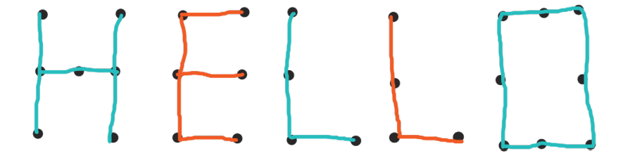
Join the dots
Write each of your words using dots. Then, join the dots with a coloured pencil to make your word.

Slide 41
Missing letters
Write a word several times, each time missing one more letter to fill in. Fold the page to hide the word above, but you can peep of you get stuck! e.g home
_ome
_ _ me
_ _ _ e
_ _ _ _

Slide 42
ABC order
Write your words out in alphabetical order.
apple
banana
carrot
appreciate
conscience
delegate
decide
honest
sincere

Slide 43
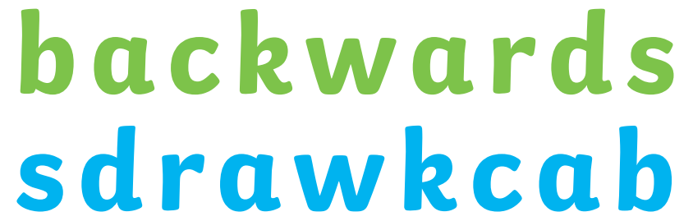
Backwards Words
Write your words out forwards then backwards.

Slide 44
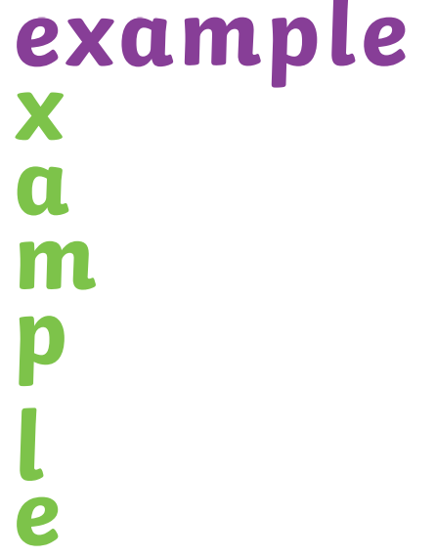
Across and down
Write your words across and down, sharing the same first letter.

Slide 45
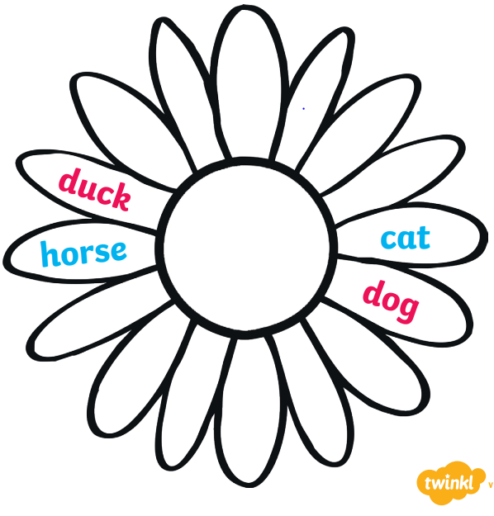
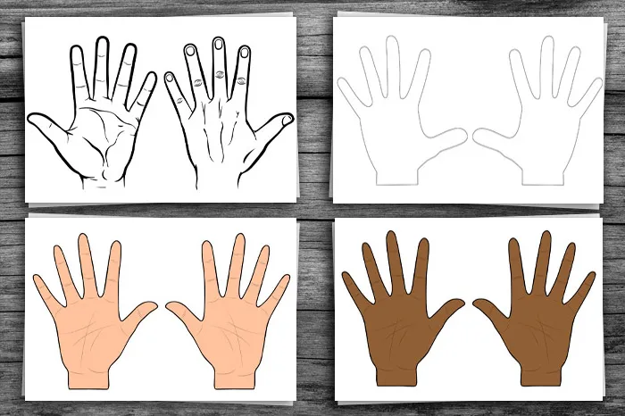
Spelling flowers or hands
Draw a big flower. Write each of your spelling words on one of the petals!

Slide 46
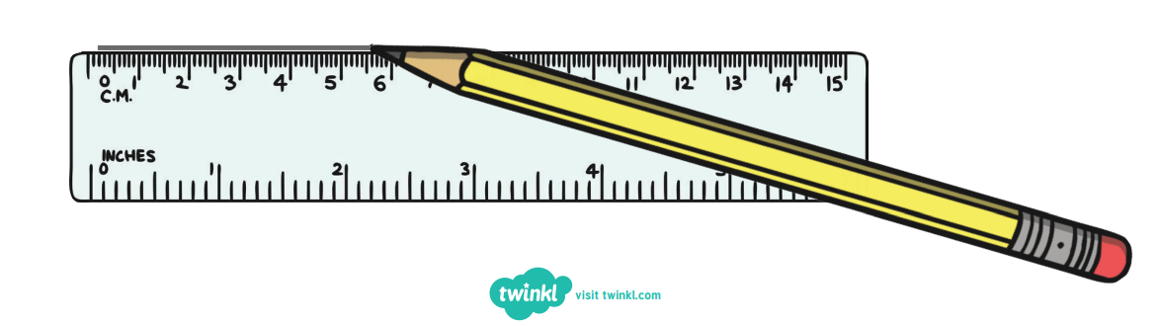
Tell a Story
Use all of your spelling words in a short story that makes sense! Underline your words with a ruler.

Slide 47
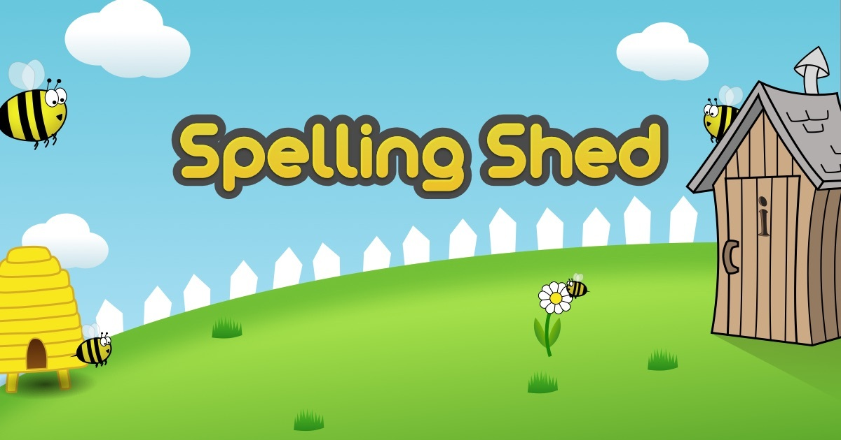
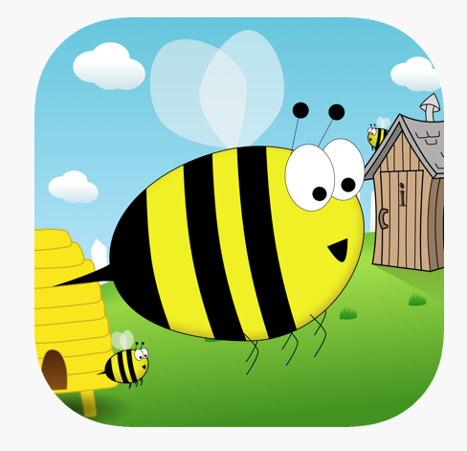
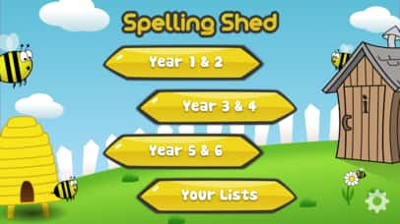
A wonderful resource at your fingertips!
https://www.edshed.com/en-gb

Slide 48

Any questions?

