Slide 2

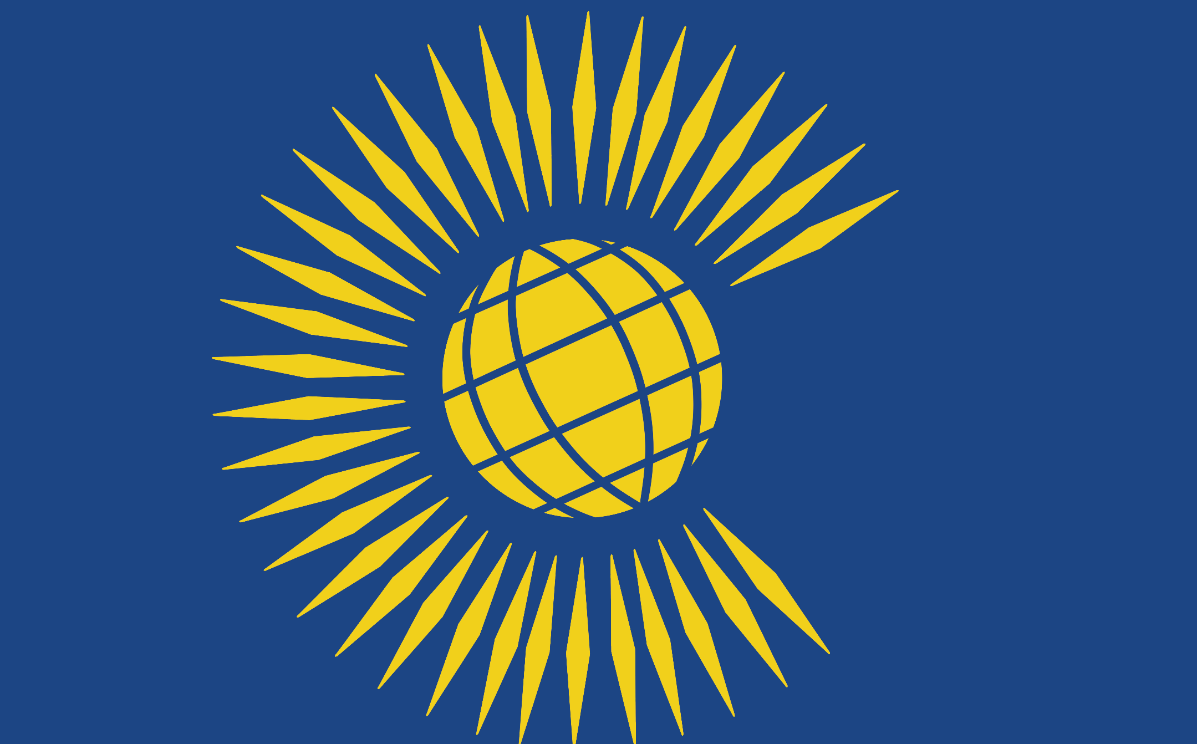
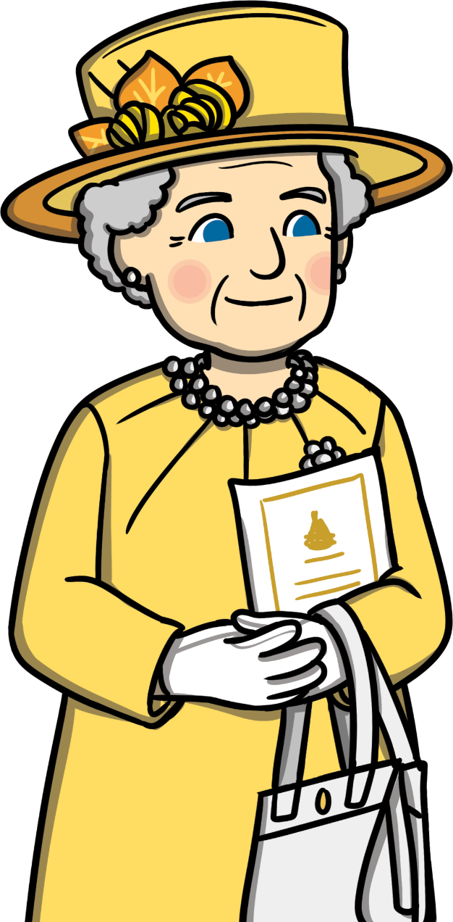
What Is The Commonwealth?
The Commonwealth is a group of nations that were once part of the British Empire.
It includes countries from Africa, Asia, South America, Europe and Oceania.
Today, many of the nations are independent; however, some still have The Queen as their head of state.
Even though these countries are very different, they all agree that certain things are important.
These ideas include the importance of countries working together to make the world better and trying to make the world a fair place for everyone.

Slide 3
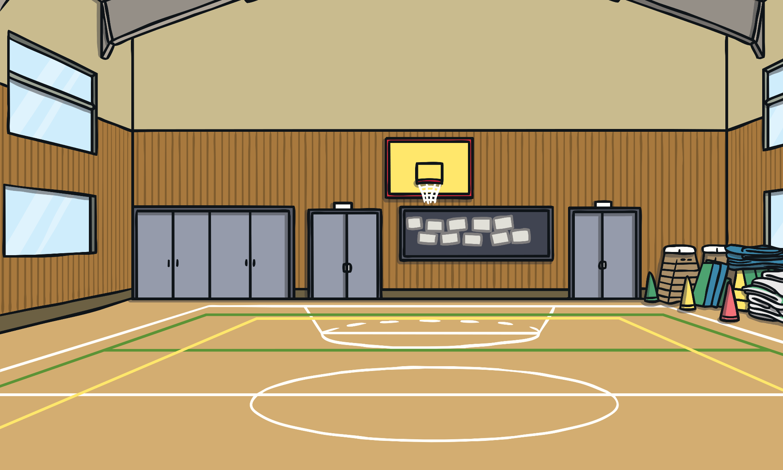
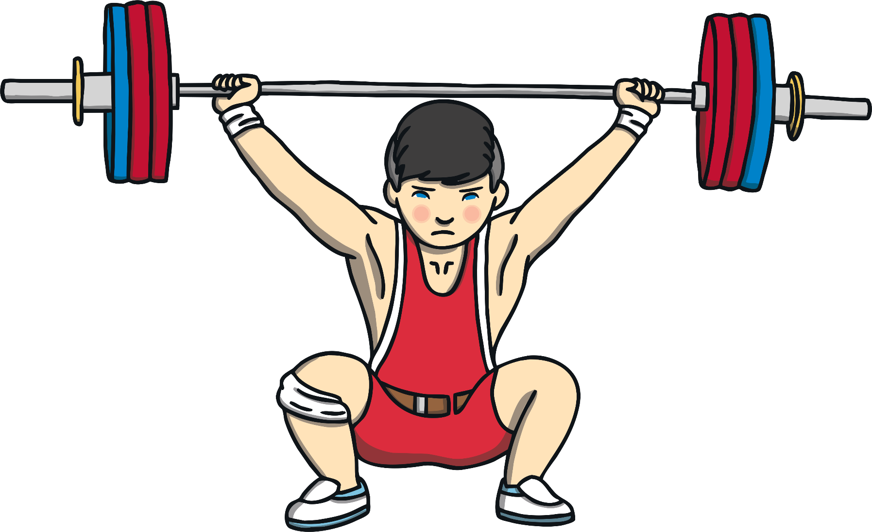
What Are The Commonwealth Games?
Every four years, countries from the Commonwealth come together
to take part in a multi-sport competition.
The sports include swimming, athletics, cycling, table tennis, diving, gymnastics and many more.
Because of the close relationship between many of the competing countries, The Commonwealth Games are often referred to as ‘The Friendly Games’.

Slide 4
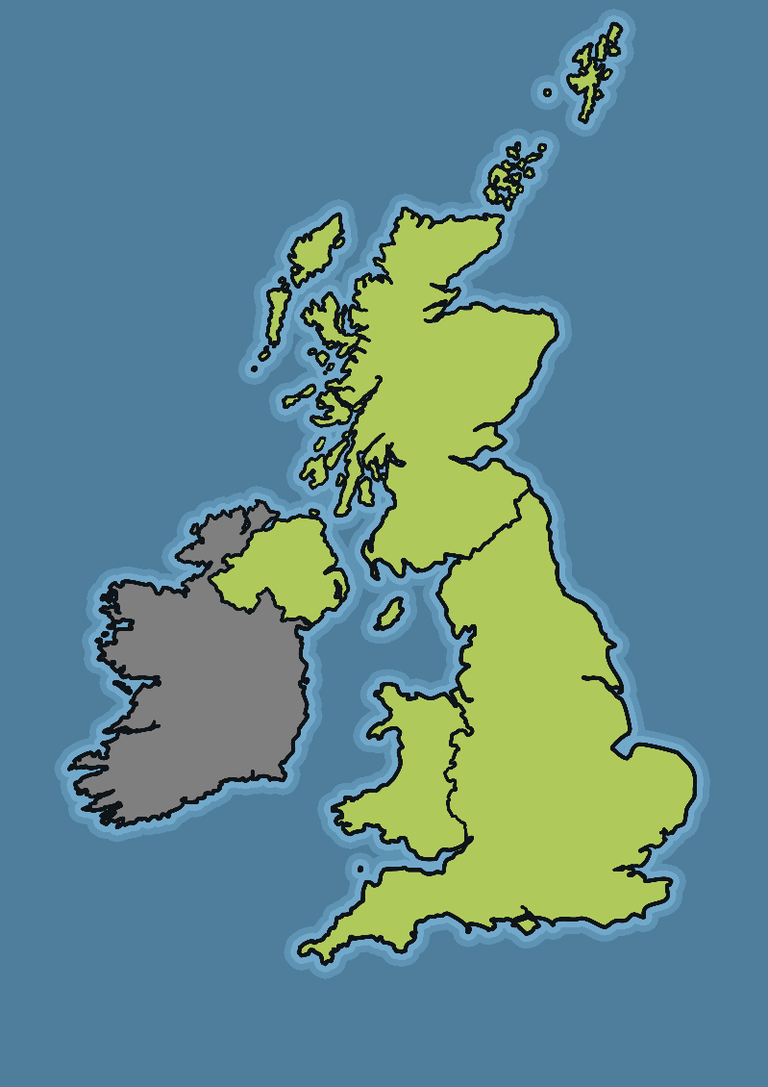
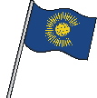
Where Are The 2022 Commonwealth Games?
The Commonwealth Games are
held in a different Commonwealth country each time.
Birmingham was chosen
to be the host of the 2022 Commonwealth Games.
The Games will take place from the 28th July to 8th August 2022.
It will be the third time that a city in England has hosted The Commonwealth Games, after Manchester held the event in 2002 and London in 1934.

Slide 5
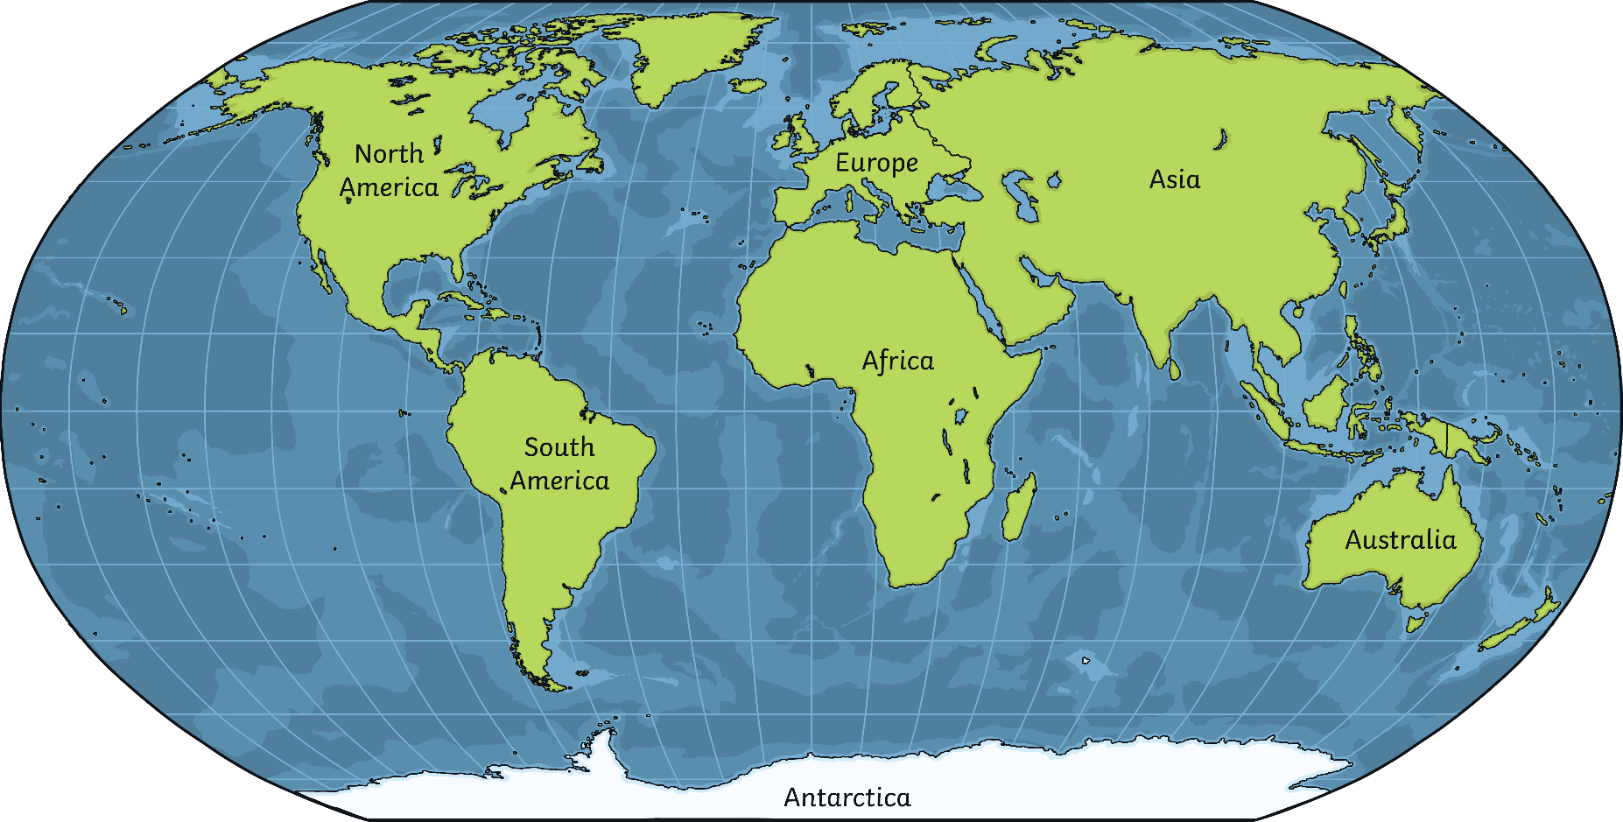
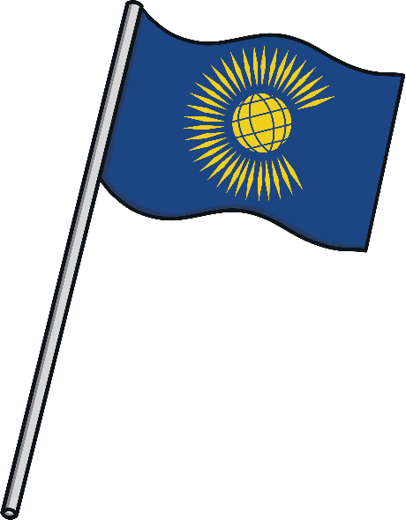
Which Countries Have Hosted
The Commonwealth Games?
As of 2022, The Commonwealth Games has been held in nine countries
across the world. Can you remember where this year's event is being held?

Slide 6
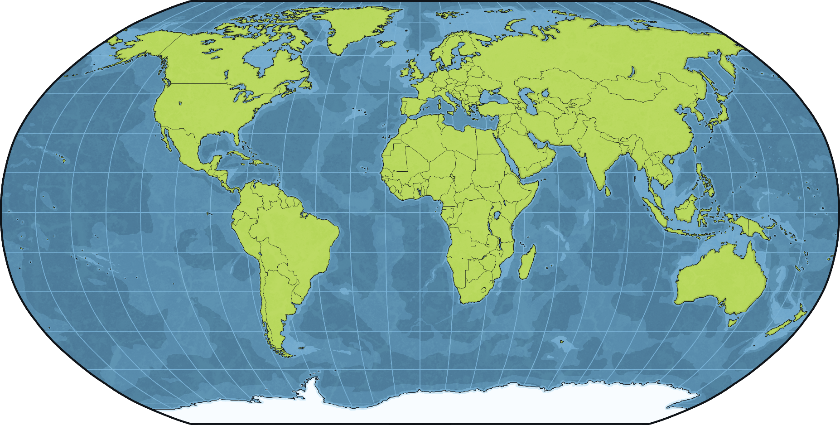
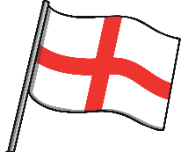
London, England 1934
Glasgow, Scotland 2014
Edinburgh, Scotland
1970 & 1986
Manchester, England 2002
Cardiff, Wales 1958
London, England 1934
Glasgow, Scotland 2014
Edinburgh, Scotland
1970 & 1986
Manchester, England 2002
Cardiff, Wales 1958
Delhi, India 2010
Victoria, Canada 1994
Delhi, India 2010
Edmonton, Canada 1978
Gold Coast, Australia 2018
Edmonton, Canada 1978
Gold Coast, Australia 2018
Edmonton, Canada 1978
Christchurch, New Zealand 1974
Christchurch, New Zealand 1974
Hamilton, Canada 1930
Hamilton, Canada 1930
This year's event will be held
in Birmingham, England.
Vancouver, Canada 1954
Vancouver, Canada 1954
Auckland, New Zealand 1950 & 1990
Auckland, New Zealand 1950 & 1990
Kingston, Jamaica 1966
Kingston, Jamaica 1966
Kuala Lumpur, Malaysia 1998
Perth, Australia 1962
Brisbane, Australia 1982
Sydney, Australia 1938
Melbourne, Australia 2006
Kuala Lumpur, Malaysia 1998
Perth, Australia 1962
Brisbane, Australia 1982
Sydney, Australia 1938
Melbourne, Australia 2006

Slide 7
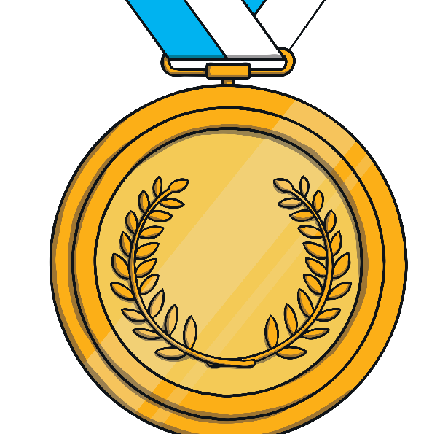

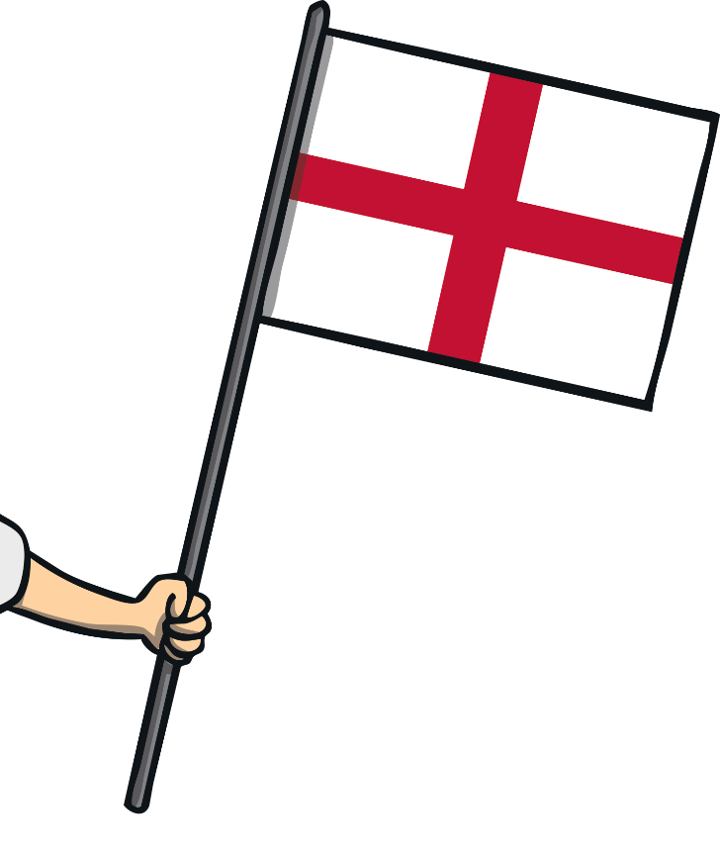
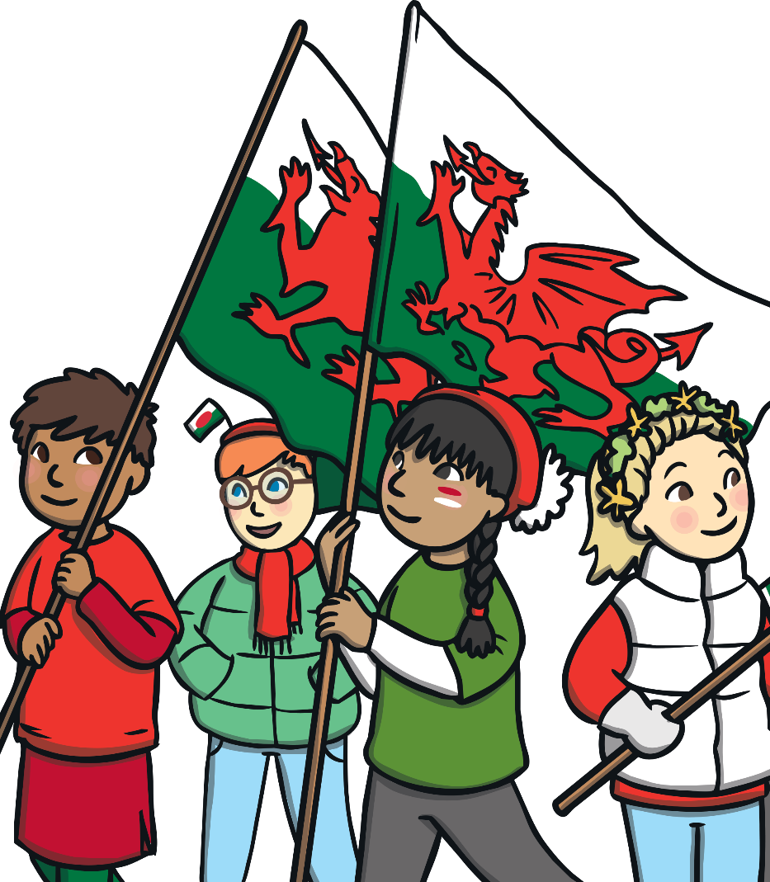

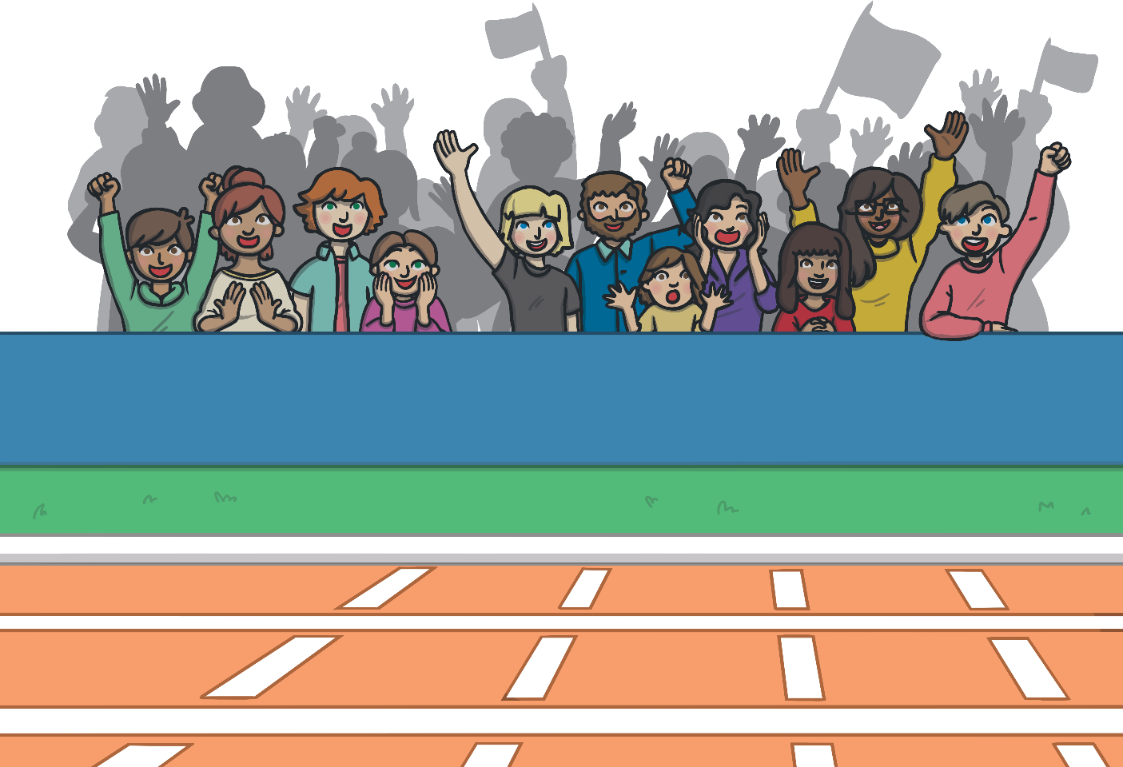
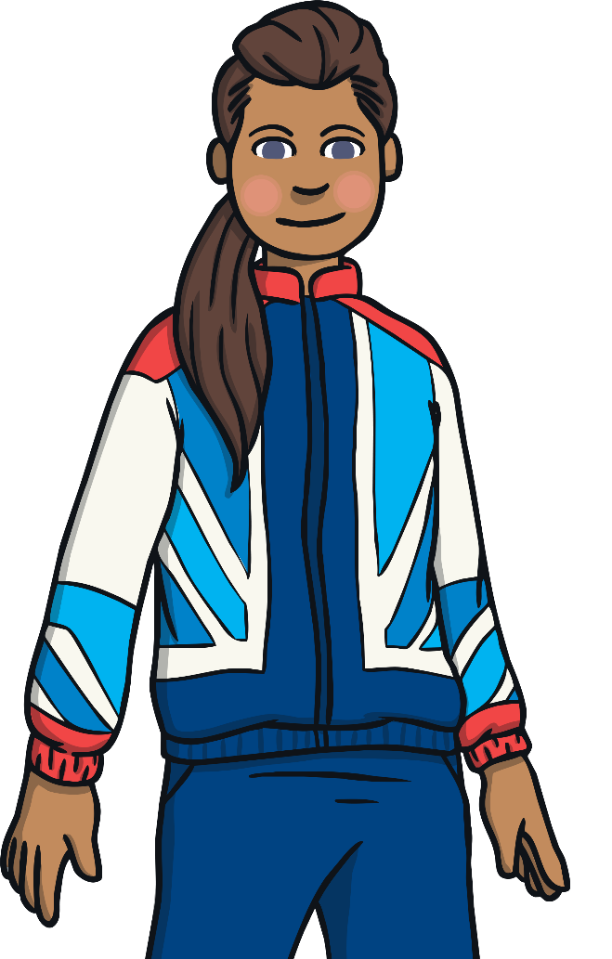
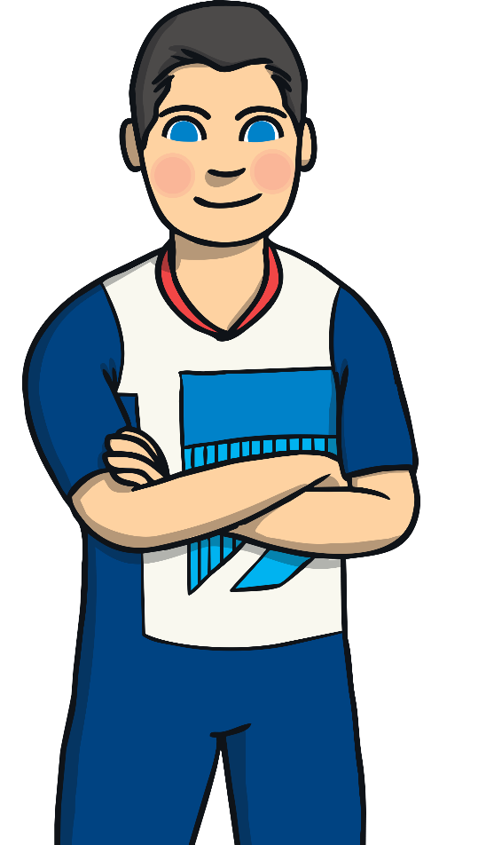
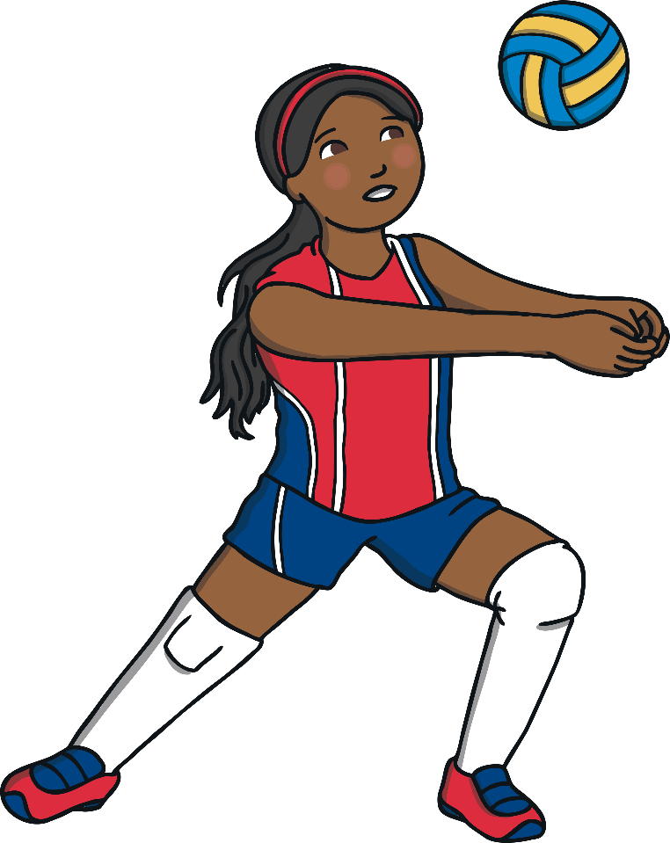
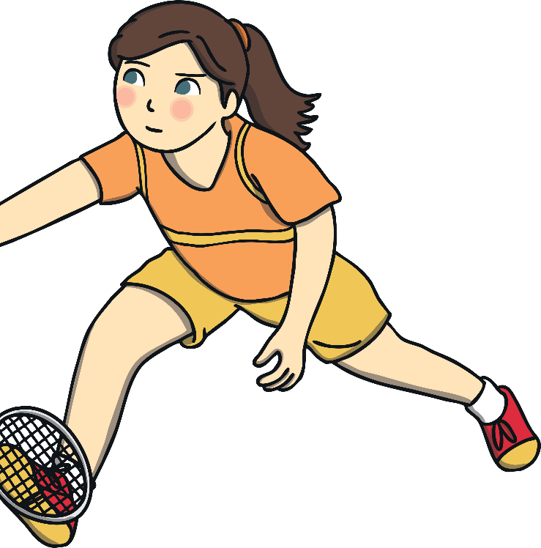
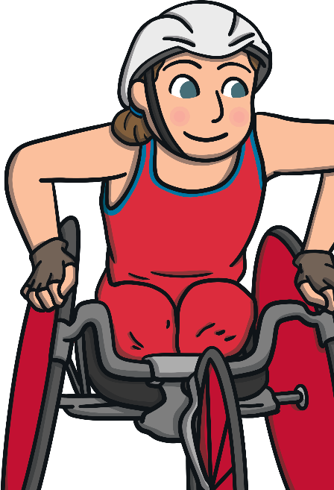
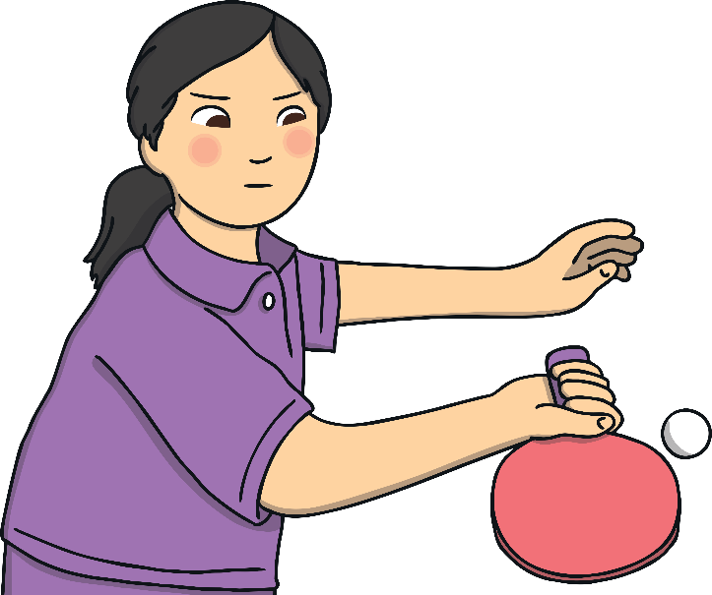
What Happens At The Commonwealth Games?
At the start of each Commonwealth Games, there is an opening ceremony. The athletes from the participating nations walk into the stadium, behind their country’s flag.
When athletes compete in their events, they have the opportunity to win a gold, silver or bronze medal for coming first, second or third.
The nation that is hosting the Games will put on a special performance,
to celebrate what is good about their country.

Slide 8
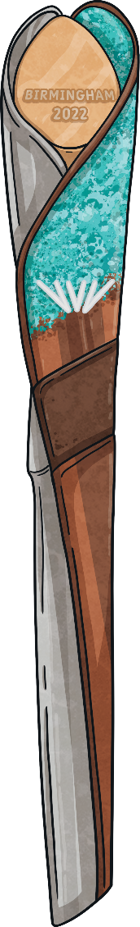
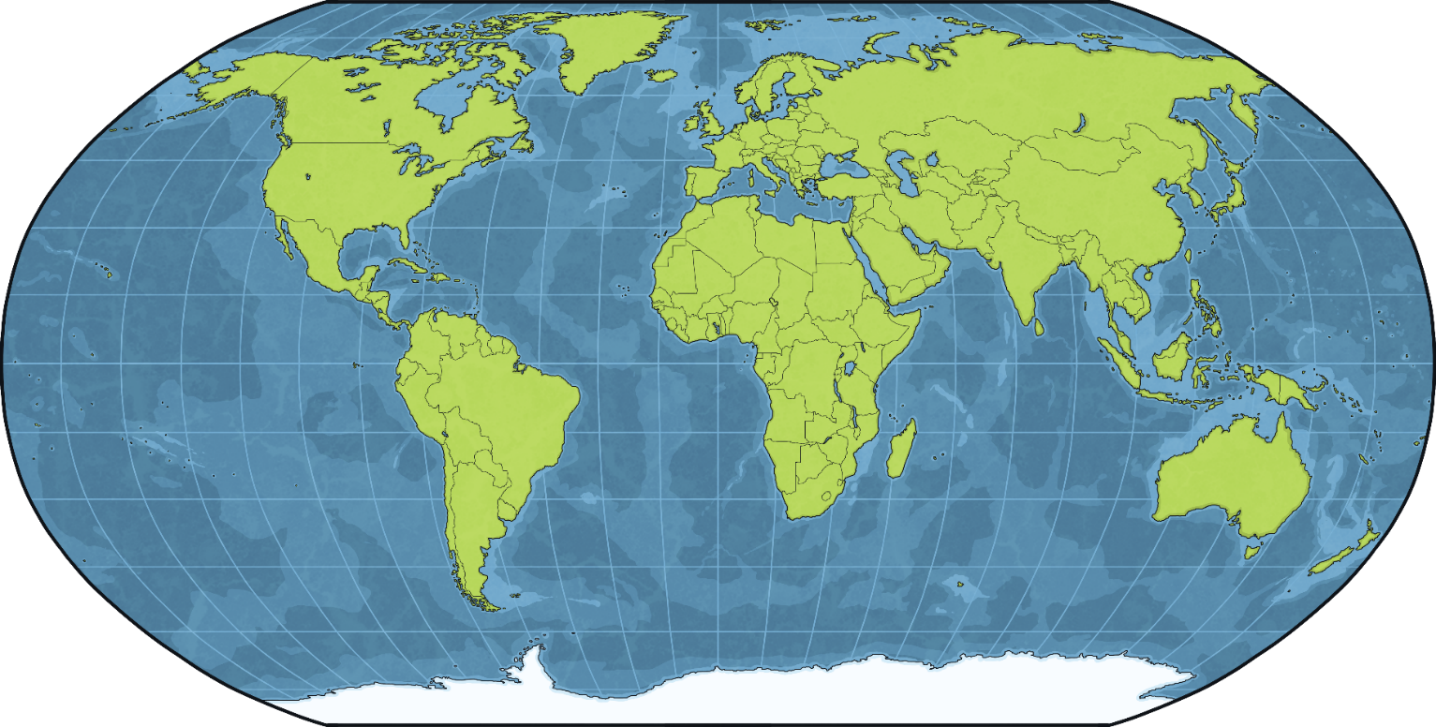


The Queen’s Baton Relay
The Commonwealth Games has a special baton called the
Queen’s Baton. The baton relay starts at Buckingham Palace.
The baton is carried by different people around Commonwealth
countries before arriving at the opening ceremony.
It helps to make the people in each country feel like they are a part of The Commonwealth Games.

Slide 9
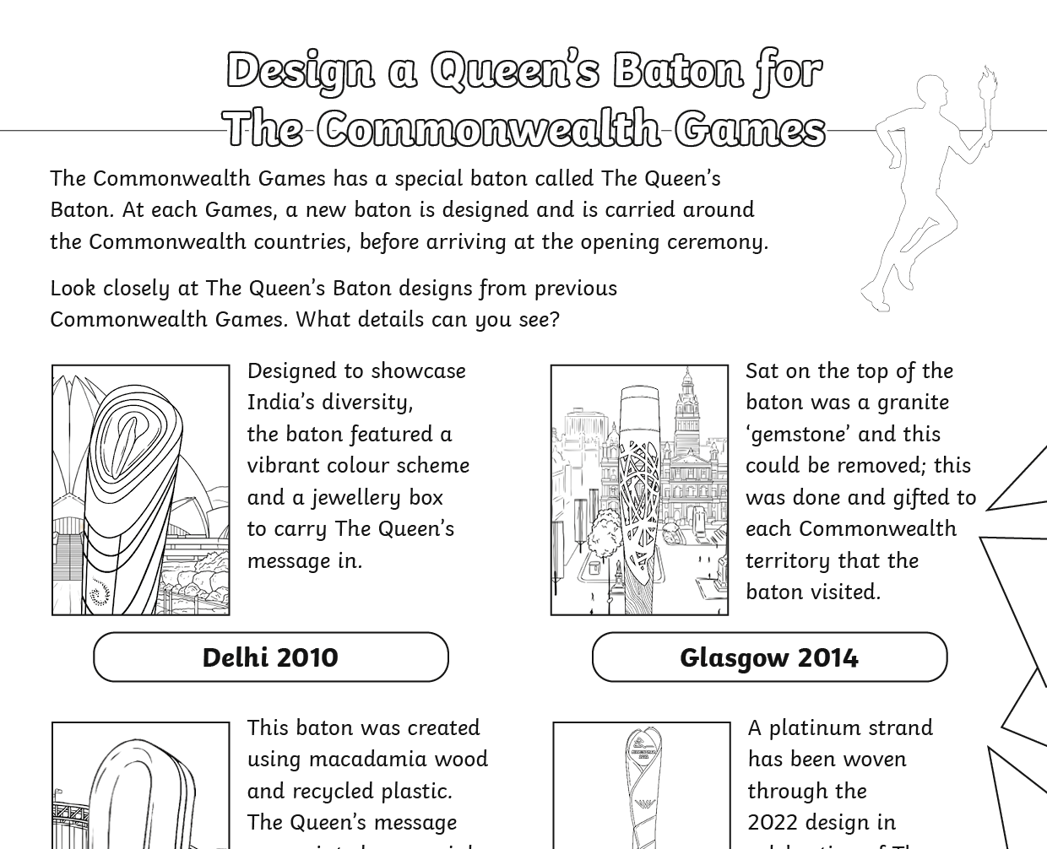


The Queen’s Baton Relay
If you could design a Queen’s Baton for The Commonwealth Games,
what would it look like?
You can have a go at this activity with our
Design a Commonwealth Games Queen’s Baton resource!

Slide 10

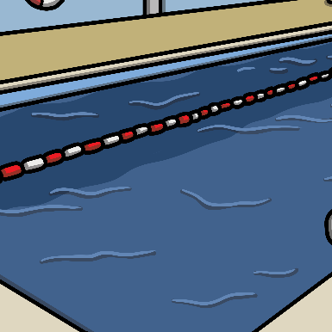
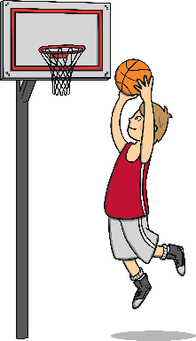
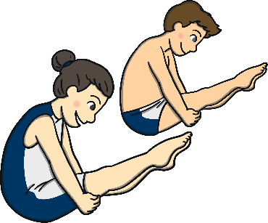

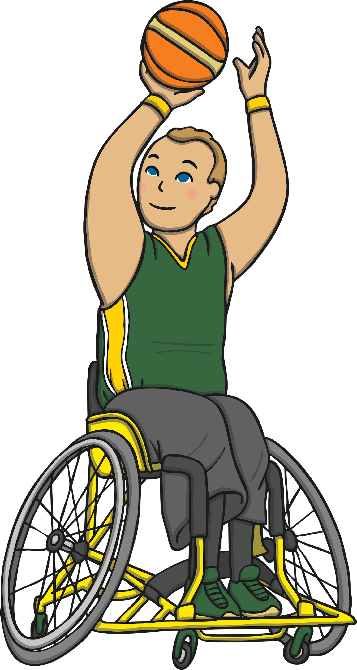
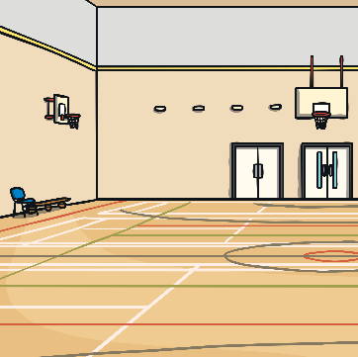

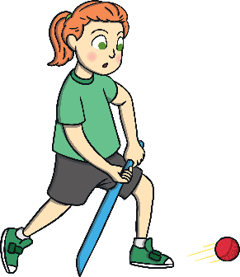

What Sports Are Involved?
The number of sports and events at The Commonwealth Games has grown over the years. This year, over 250 finals will be played across 20 sports.
Look out for some of the new sports that will feature at the Birmingham 2022 games:
Basketball 3x3
Mixed Synchronized Diving
For the first time in Commonwealth Games history,
there will be more female events than male events.
Wheelchair
Basketball 3x3
Women’s Cricket

Slide 11


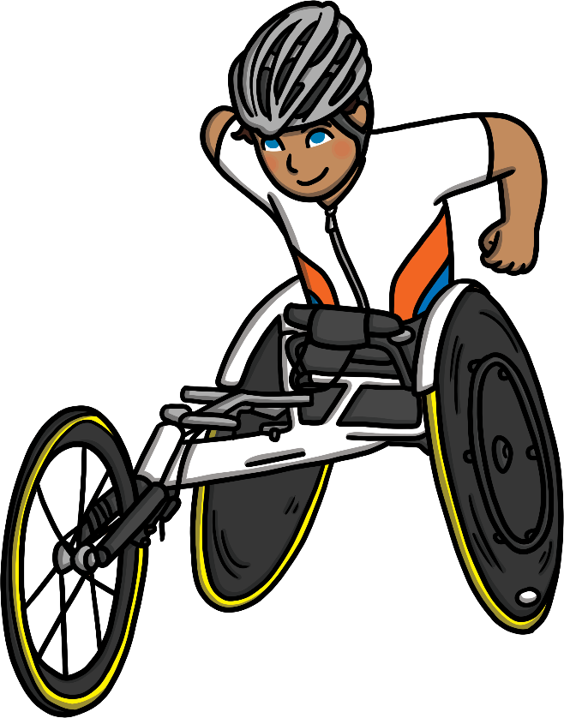
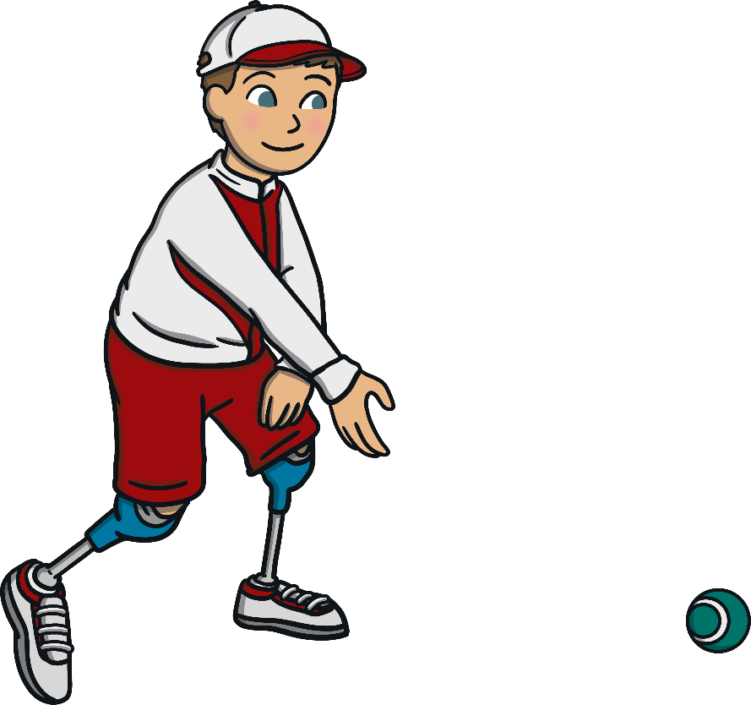
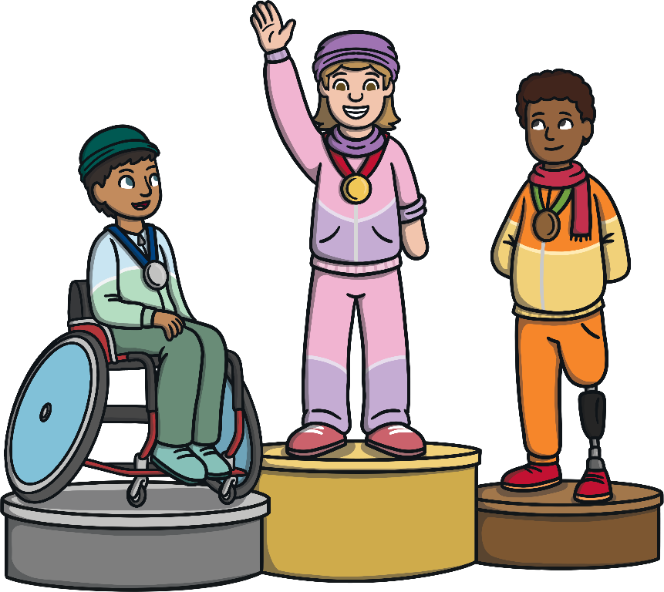
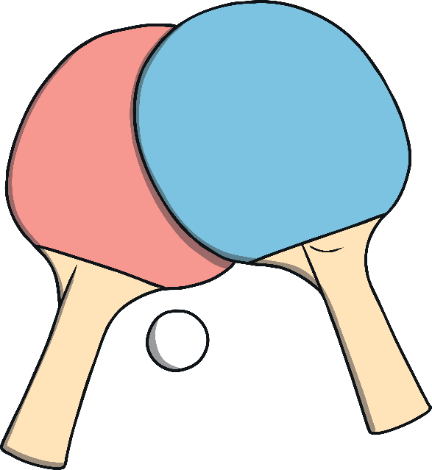
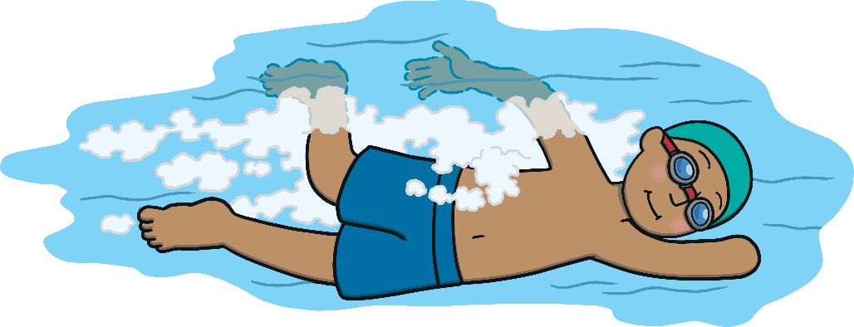
Para Sport At The 2022 Games
The 2022 Games will feature the largest Para Sport programme
in Commonwealth Games history.
It will feature:
Para Athletics
Para Powerlifting
Para Athletics
Para Powerlifting
Wheelchair Basketball
Para Track
Wheelchair Basketball
Para Track
Para Swimming
Para Triathlon
Para Swimming
Para Triathlon
Para Lawn Bowls
Para Table Tennis
Para Lawn Bowls
Para Table Tennis

Slide 12

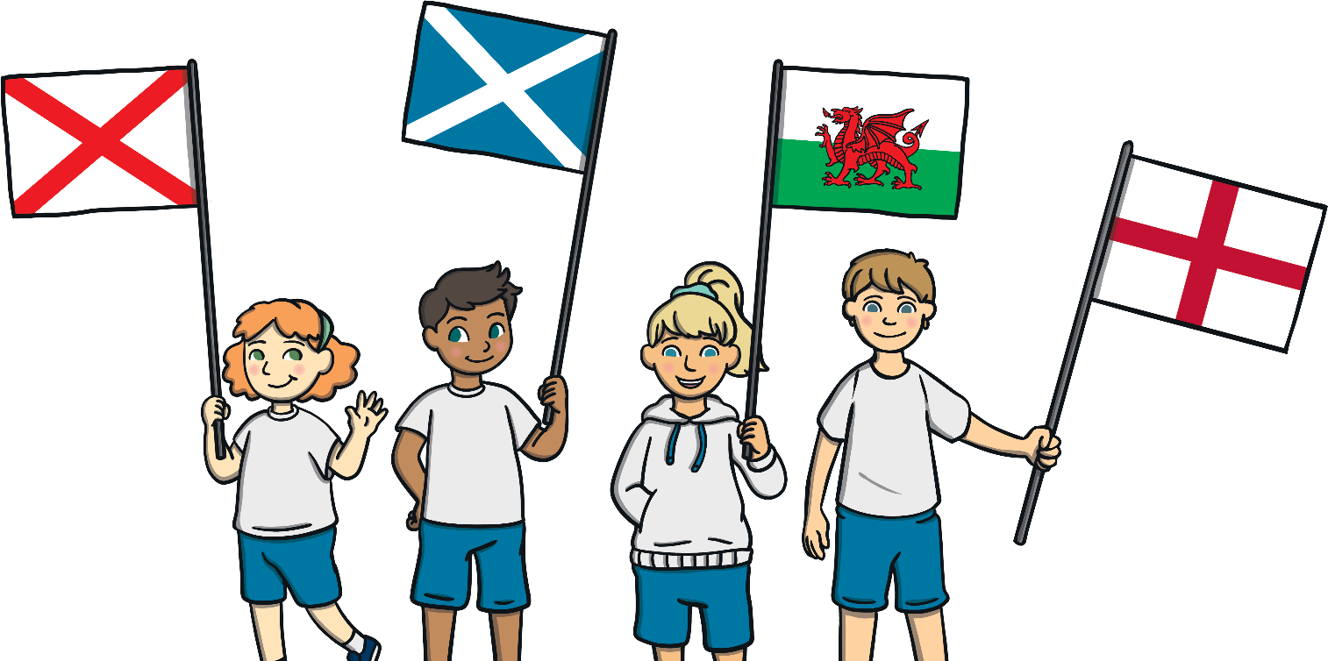
The Teams – Home Nations
At the Olympics, England, Northern Ireland, Scotland and Wales compete together as Team GB. In The Commonwealth Games, each of these countries has its own team.
Who will you be supporting at The 2022 Commonwealth Games?

Slide 13

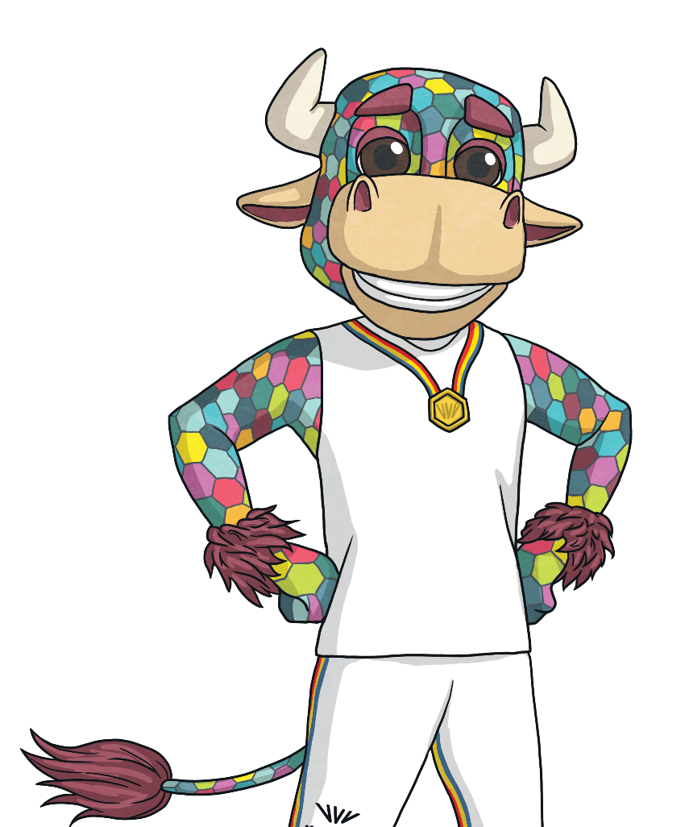
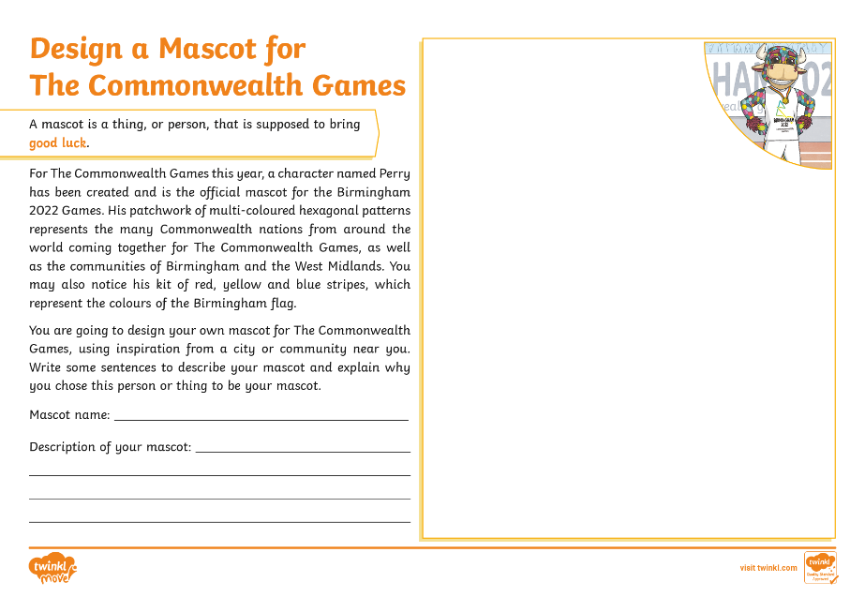
The Mascot
Each Commonwealth Games has a mascot. At the 2022 Commonwealth Games, the mascot is a multi-coloured bull called Perry.
If you could design a mascot for The Commonwealth Games, what would it look like?
You can have a go at this activity with our Design a Mascot for The Commonwealth Games resource!

Slide 14

The Closing Ceremony
At the end of The Commonwealth Games, there is a closing ceremony held in the main stadium. The flags from each country are carried in, but this time, the athletes all come in together, instead of as separate countries.
A special award is giving to one athlete who has stood out as being a good sportsperson and for helping their team.

